Slide 1
We have been learning about….
19/11/21

Slide 2
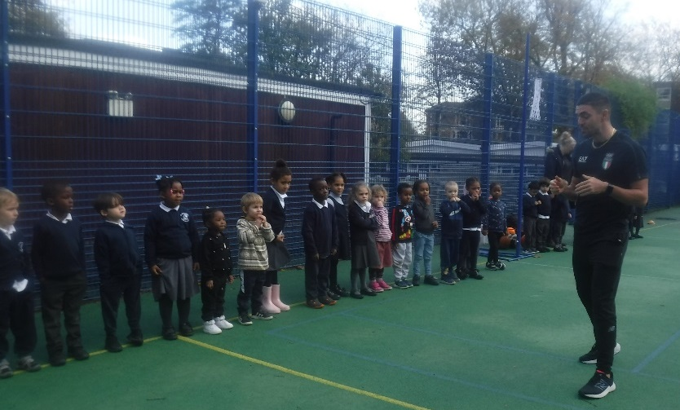
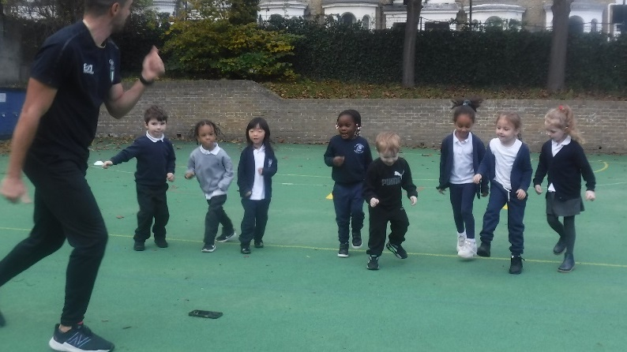
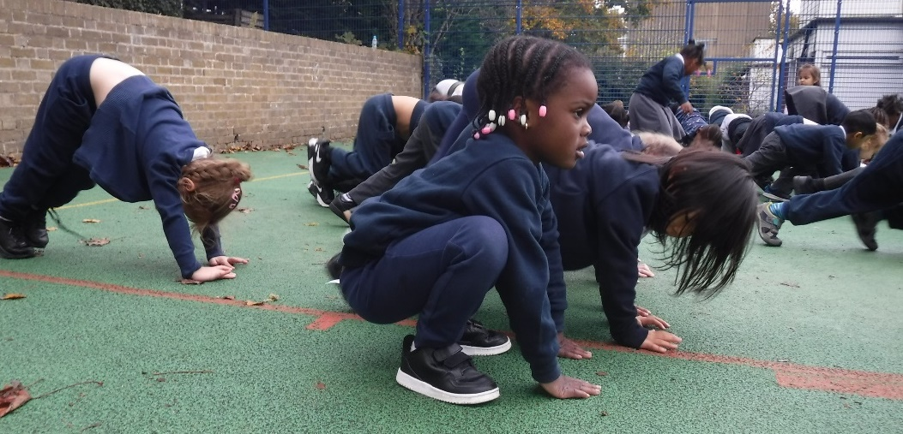
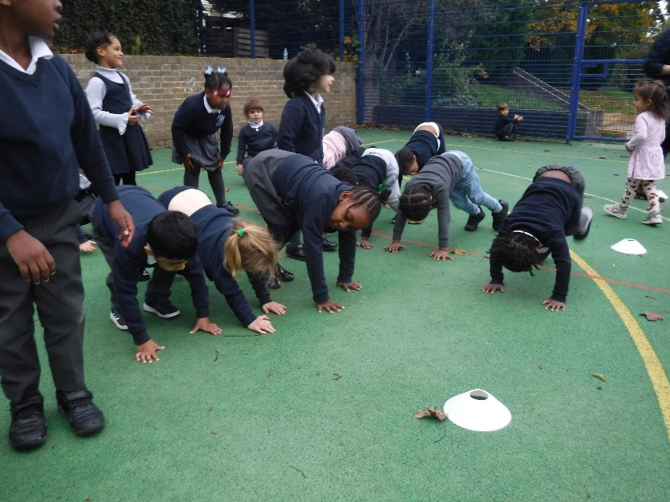
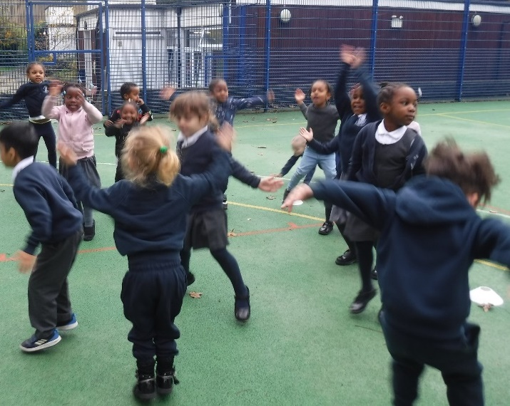
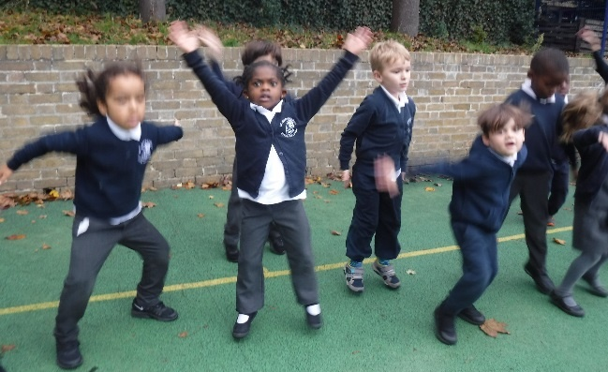
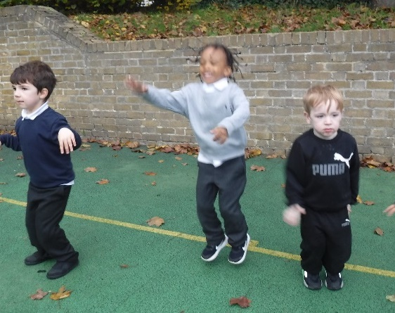
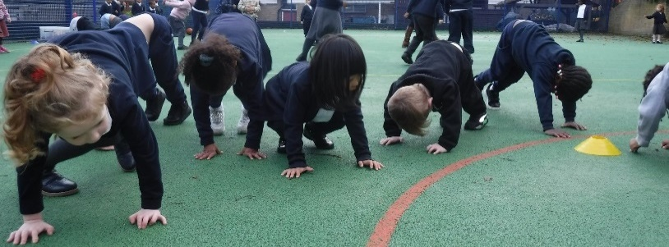
An Olympic athlete came to school to do some exercise with us!

Slide 3
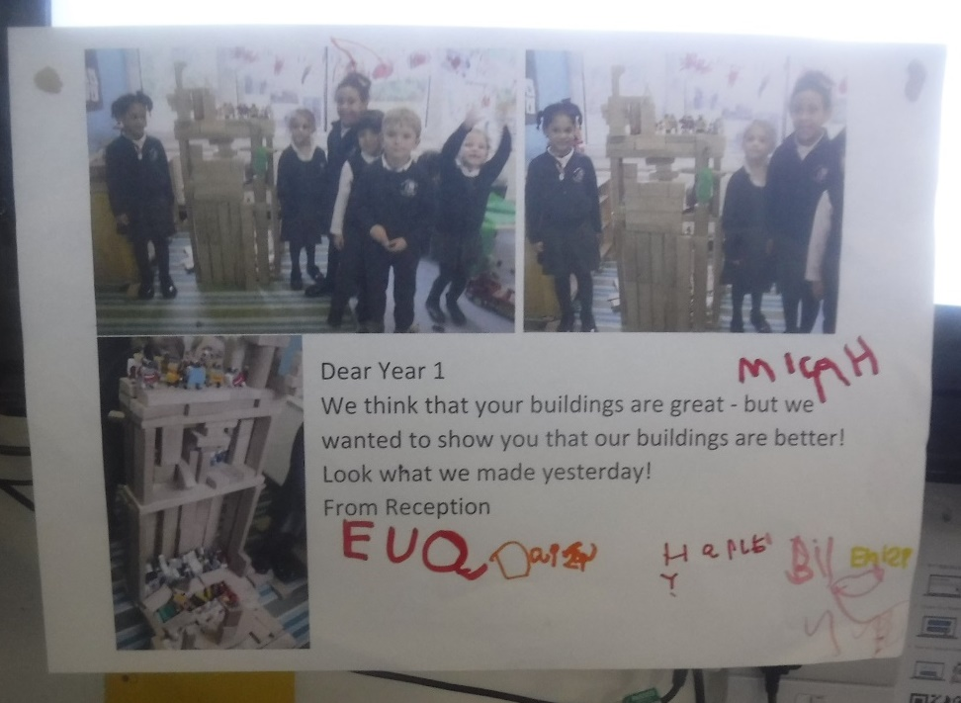
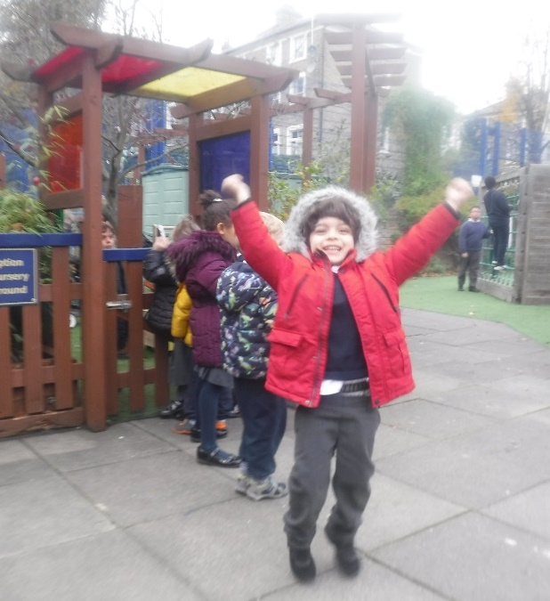
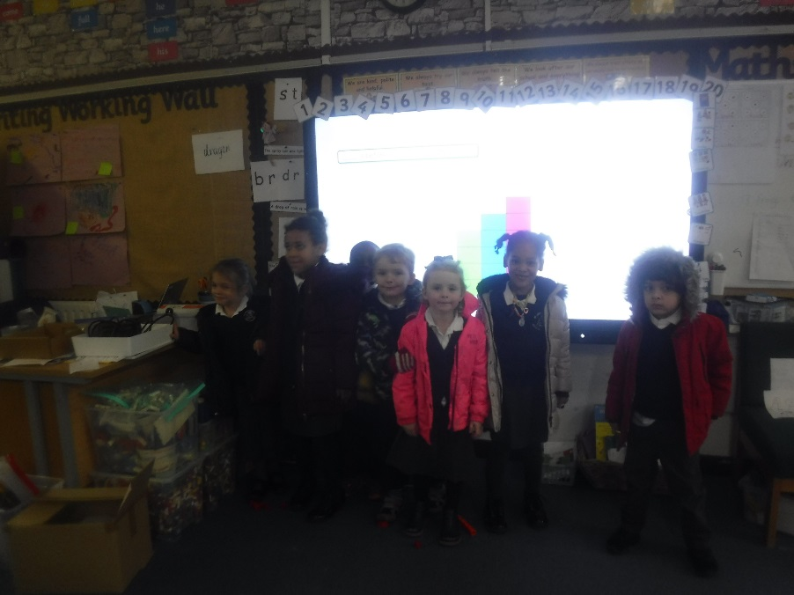
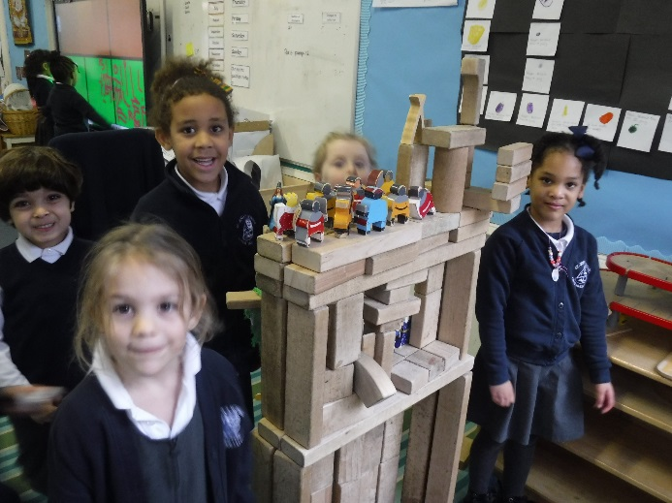
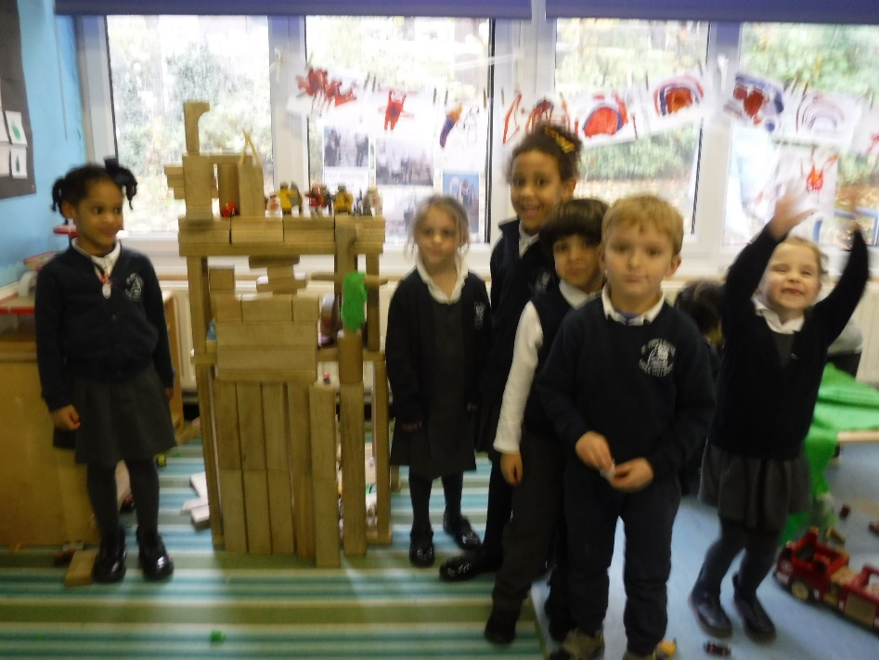
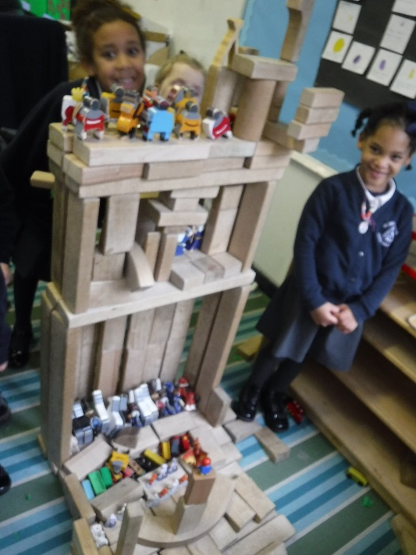
Our building were SO amazing that they were better than Year 1’s …..so we snuck into Year1 and left them a note to tell them.

Slide 4
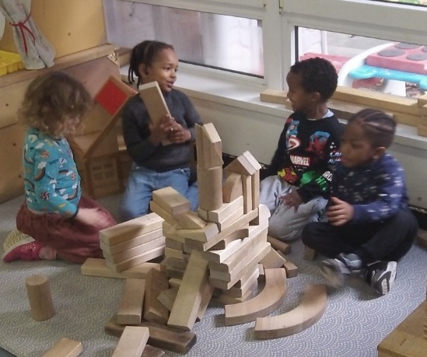
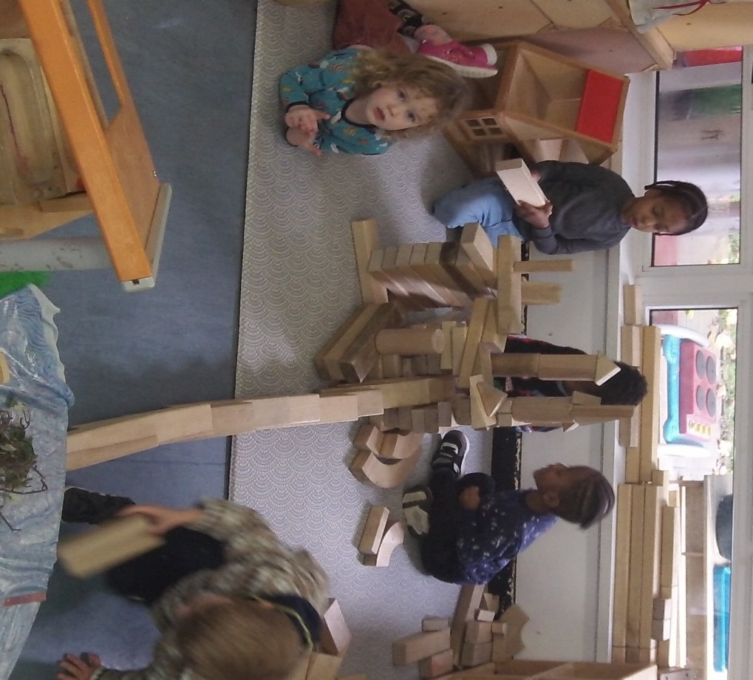
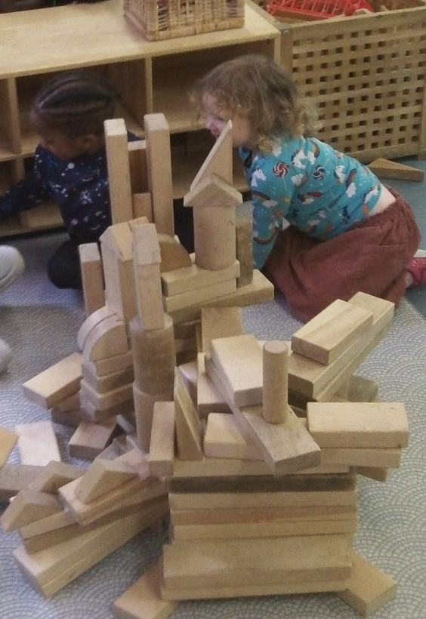
.
Brilliant building from Nursery! Tell me about your building.

Slide 5
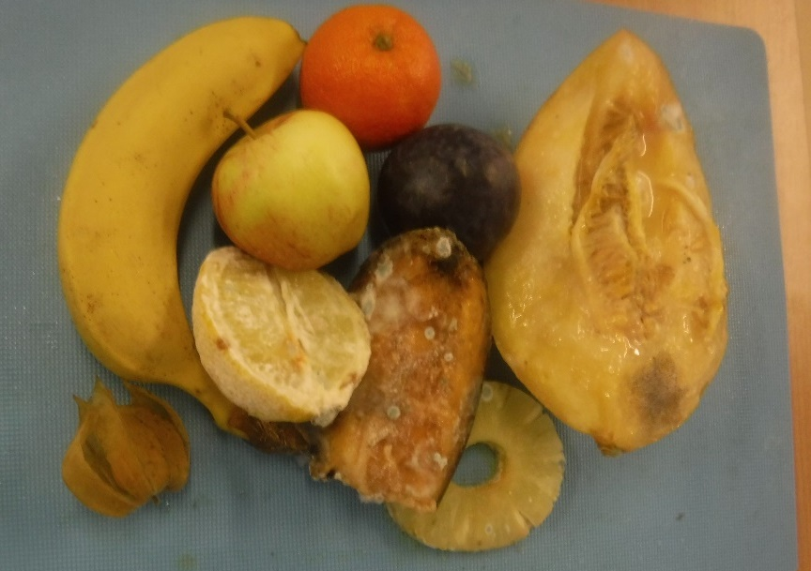
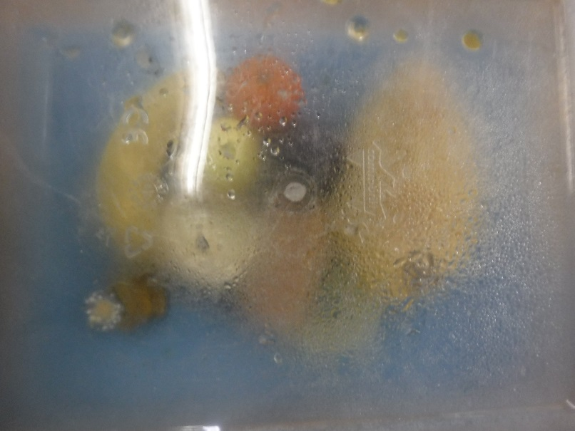
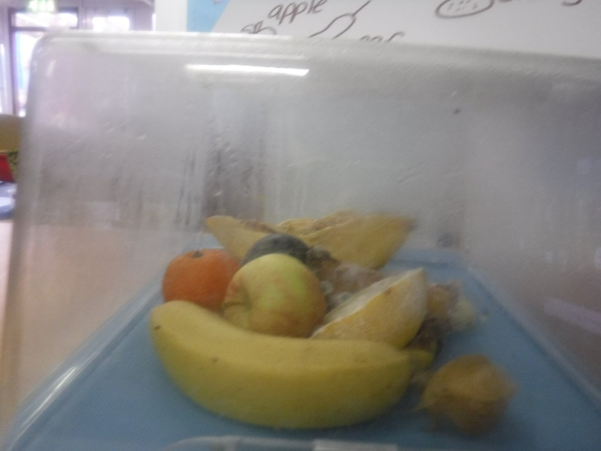
Look what has happened to the fruit in our science experiment!

Slide 6
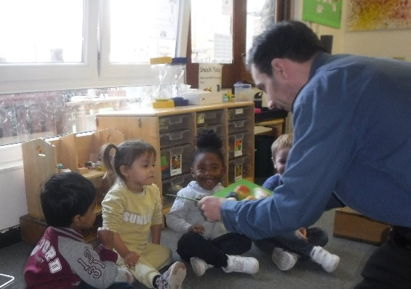
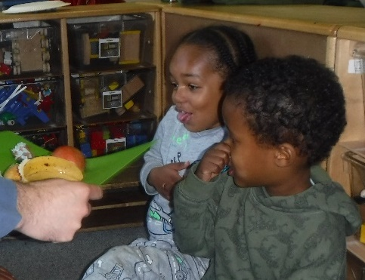
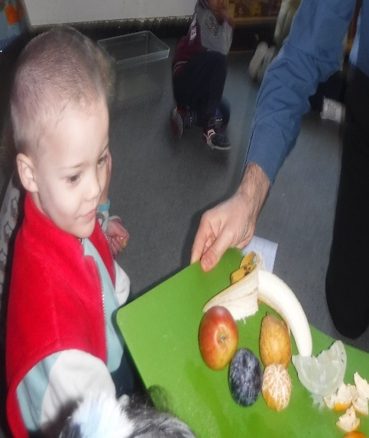
We DID NOT like the smell!!

Slide 7
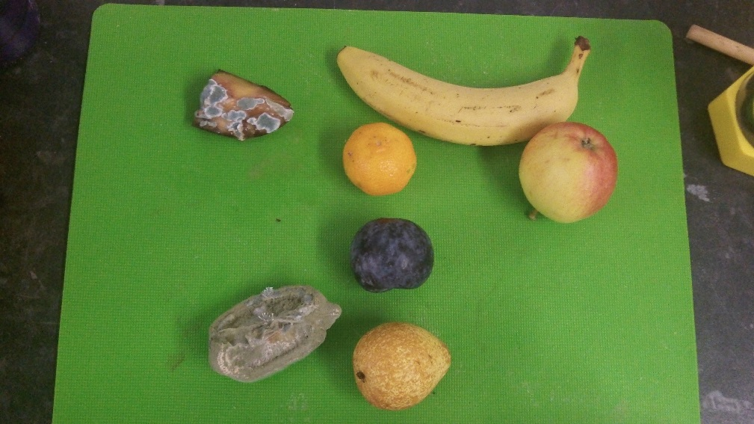
Nursery did an experiment, to see what happens to fruit over a period of time
It is yucky!! Albie
If you eat lemon you will get germs. Hamza
The banana and apple have not changed colour. Gabrianna
You will have a tummy ache if you eat the bad fruit. Adan
It smells like smelly fish. Teddy
It is very smelly. Haashim
The lemon has gone greenie, greenie, greenie. Israel
Eat the apple and banana, still good food. Zaria
The lemon has gone green and it was yellow. Hannah
Poo!! Ayoub

Slide 8
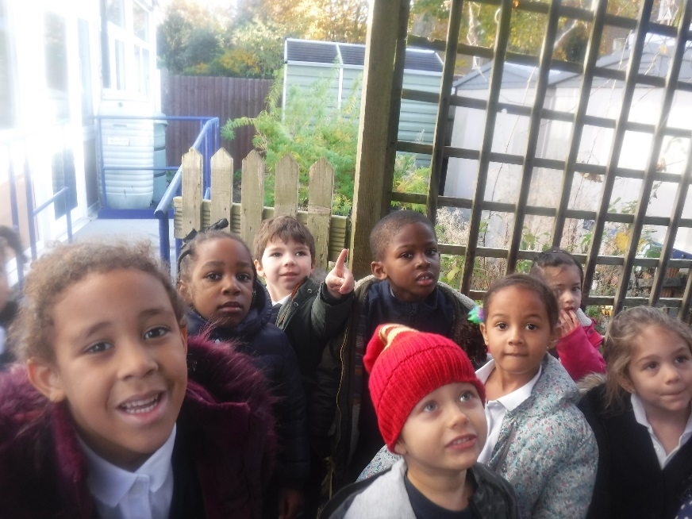
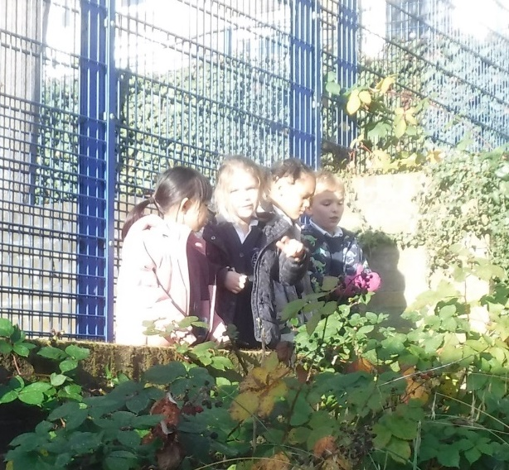
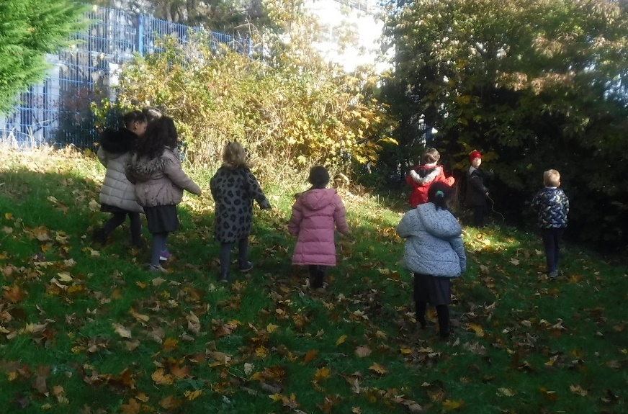
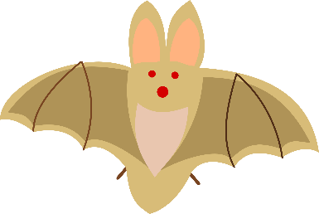
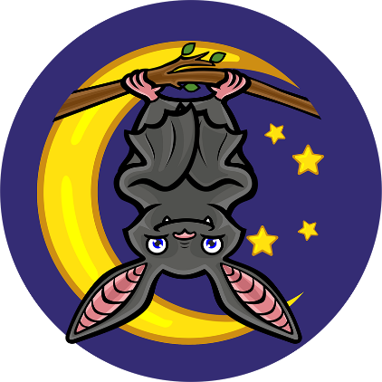
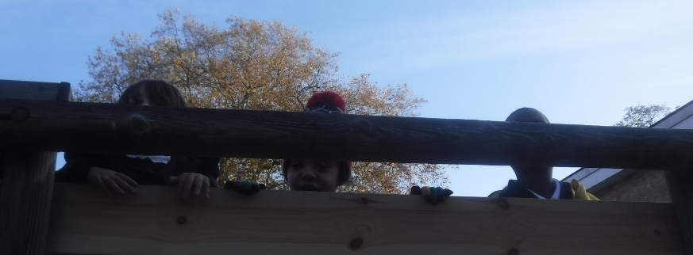
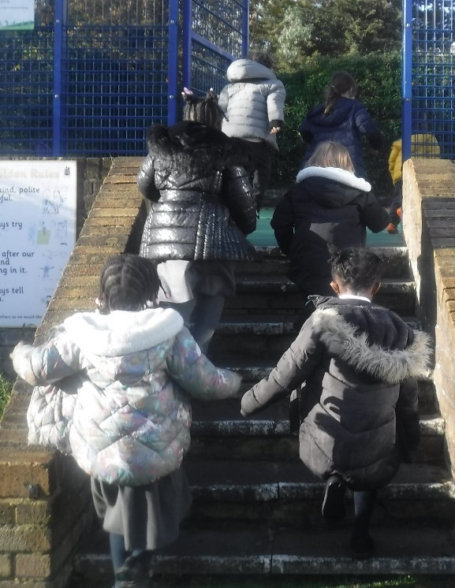
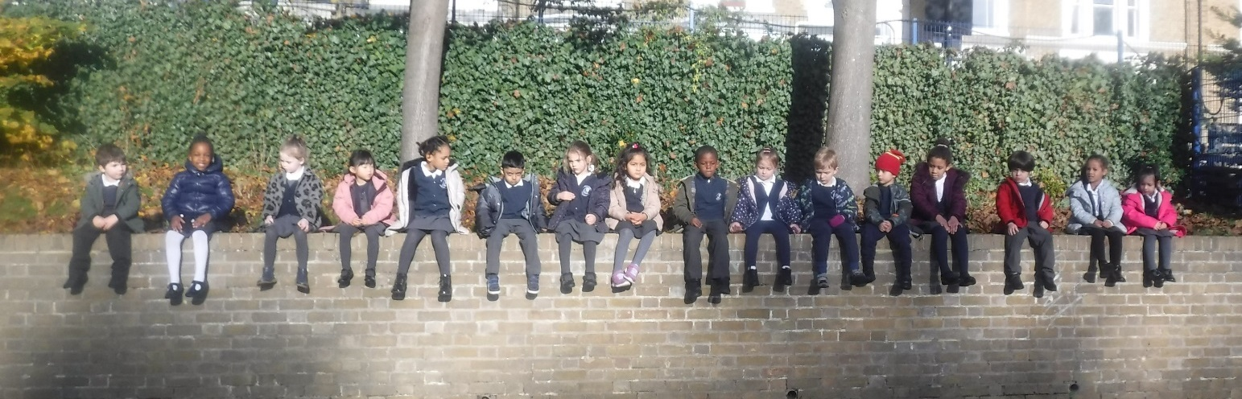
We went on a bat hunt! We looked at the school from different perspectives and used language to think about where we should look, Could the bat be up, in, under, on top, next to?
This Photo by Unknown Author is licensed under CC BY-NC-ND

Slide 9
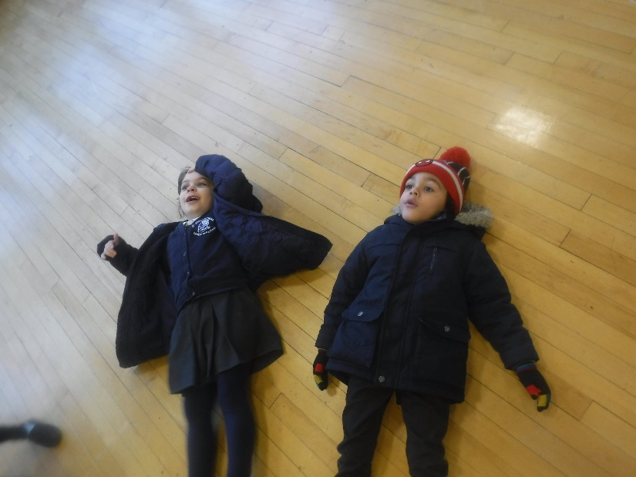
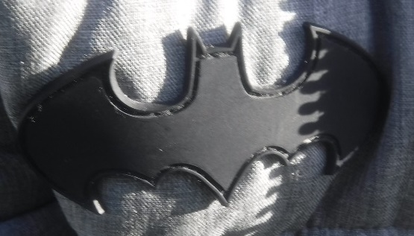
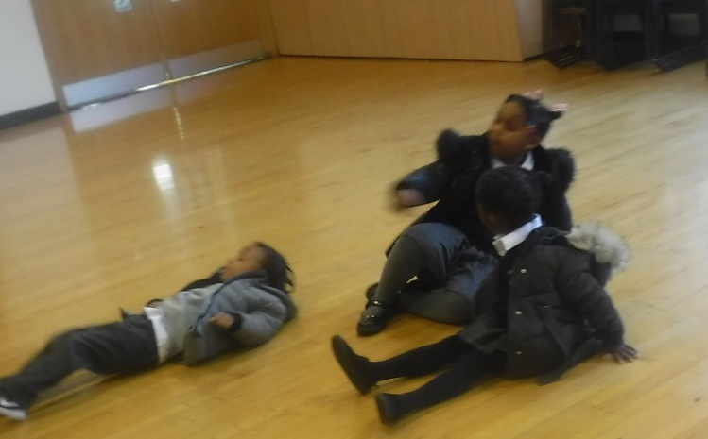
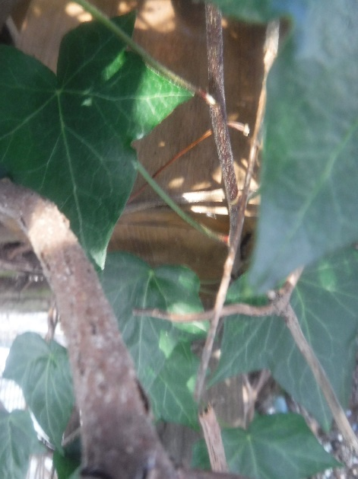
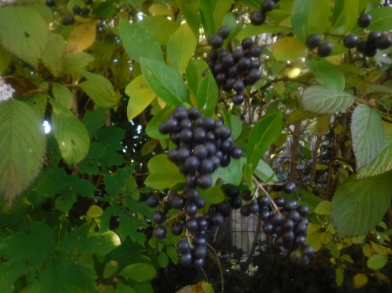
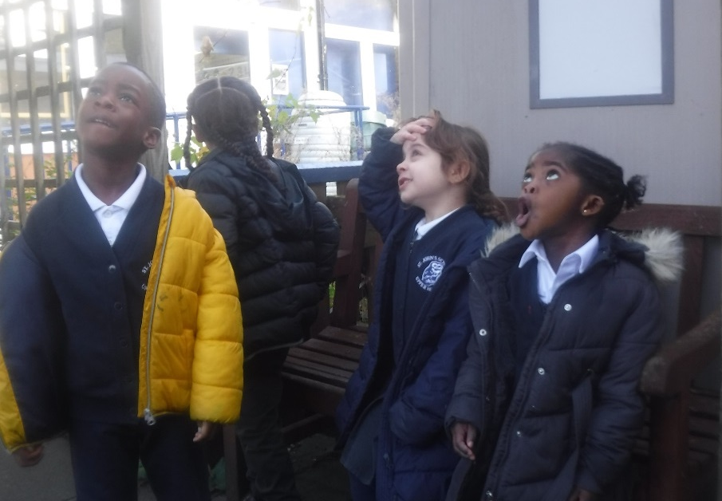
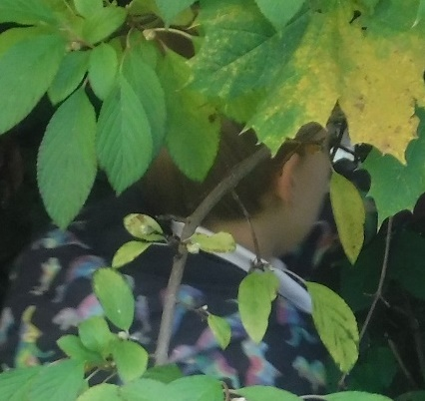
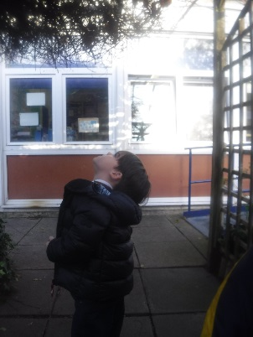
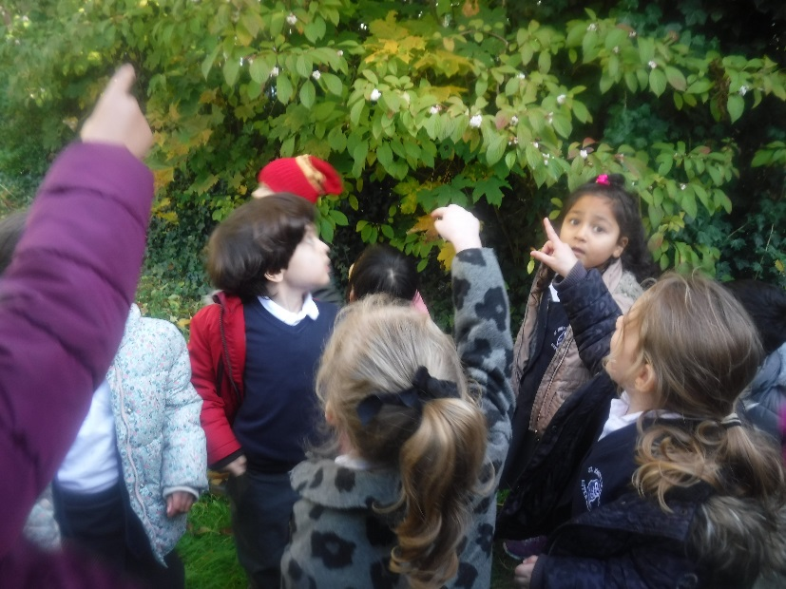
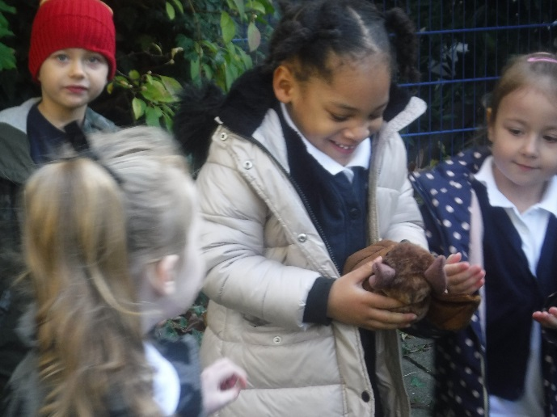
We found a bat box!
We found some fruit…..and then we found the bat!

Slide 10
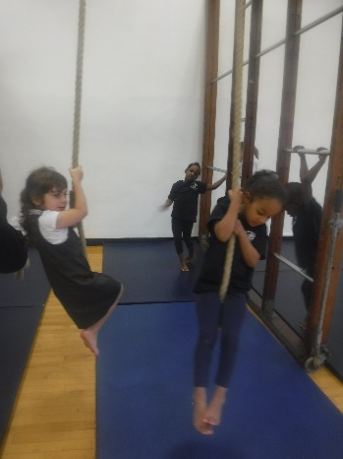
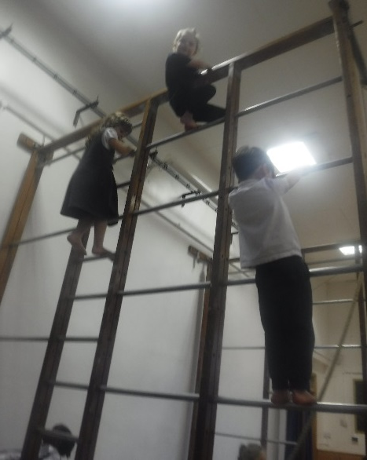
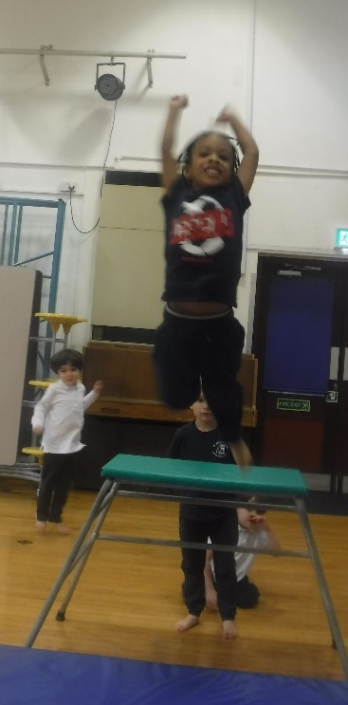
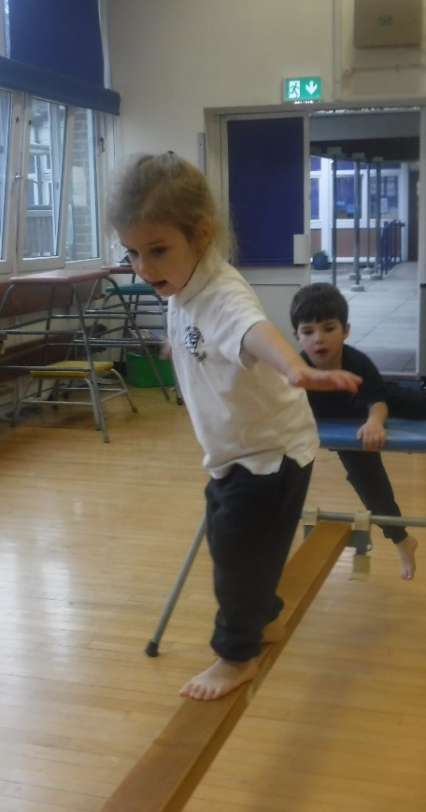
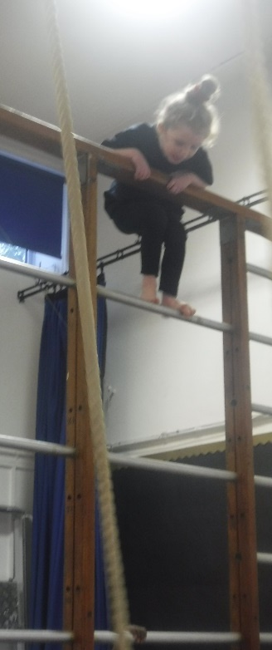
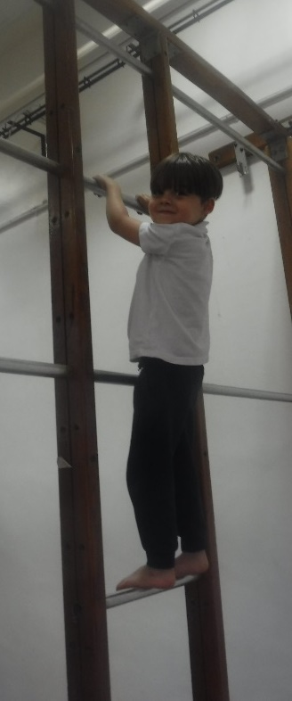
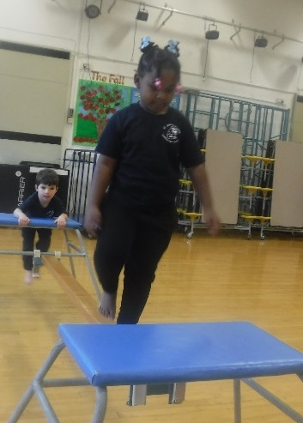
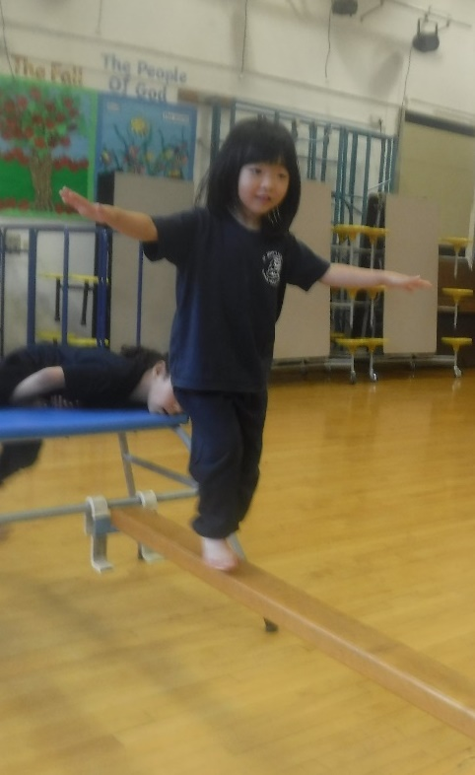



Amazing climbing and balancing in PE.

Slide 11









Slide 12












We put features on our self portraits! Can you tell who they are?

Slide 13



Slide 14

They live in Africa, we need to get on an a aeroplane because it’s far away. Hannah
In Nursery we have found out some interesting about Fruit bat.
Bats are furry and black. They come from the jungle. Olivia
A bat has a claw. Teddy
They eat bat food, fruit and vegetables. Destiny
Bats like it hot so they sleep in Africa. It is so cold here. Dolly
There’s to many humans in England, so bats can’t live there. Hamza
They eat apples and fruits. Paul
A bat is like an aeroplane. Haashim
Bat fly using their wings. They are hairy and big. Adan
Bats looks like a rat. They move, fly in the sky with their wings. Zaria
Bats hang from trees. The bat ha wings. They are found in Africa. Gabrianna

Slide 15






Hanging like fruit bats!
What else did you learn about this week?

Slide 16







Slide 17








