Slide 1
We have been learning about….
12/11/21

Slide 2
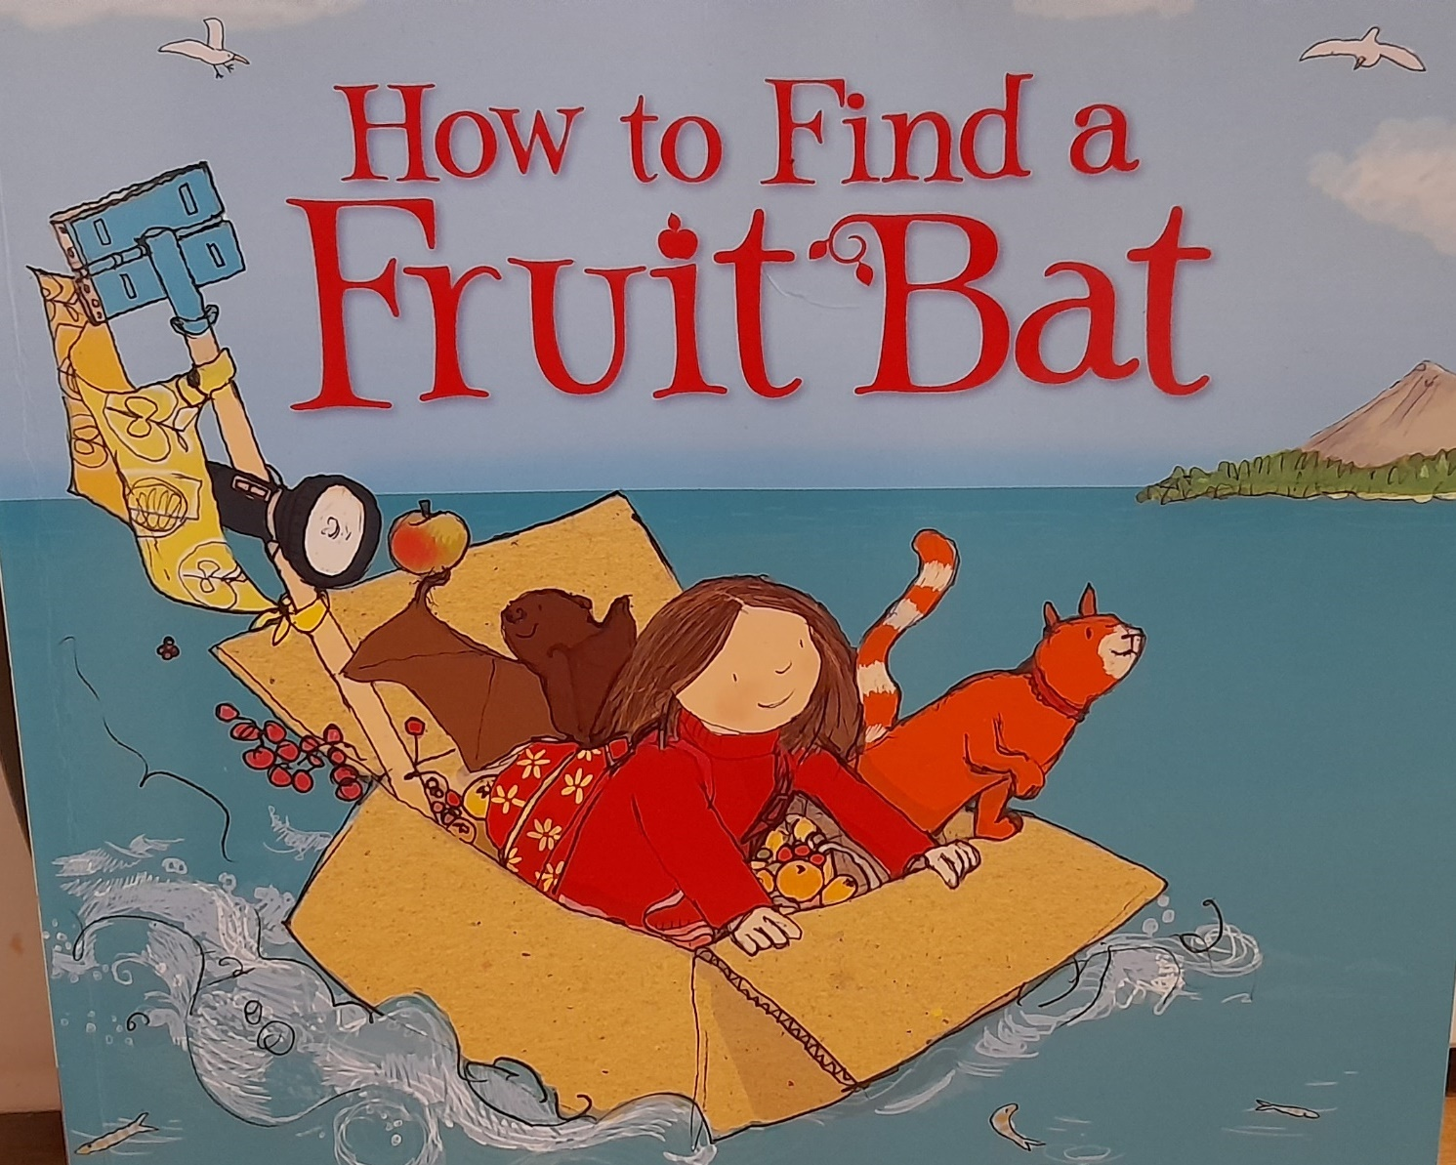
We introduced our new text. There is a bat in the story and we thought about what we already know about bats.
I have seen bats in the park. Ruby
They look like grumpy! Amedeia
Bats live in China
Abdulfattah
They fly! Gabriella
They can see in the dark. Harper.
They are the only mammals that can fly. Micah
A bat went to Halloween.
Zahra
They like fruit. Omar
I’ve seen bats in the forest. Jesse
Bats sleep upside down. Bienna
They can grab things with their feet. Mason
Bats sleep in the day. Che
Bats see in the dark. Zayn
Bats fly at night. Yasin

Slide 3
Going to the pirate. Symphony
Forever on the box. Destiny
They are happy. Hannah
To Diwali because we have to go there. Israel
The boat is on the water. Haashim
Going for a ride in the sea. Teddy
In the water, in the bubble water. Paul
I see people, I see a toy, I see a cat. Jazmiyah
To London because they are sailing on a river. Olivia
They made a box so they don’t go in the water. Dolly.
There going on a trip. There going on the beach. Adan
I think they are going on a bear hunt. Hamza
Going to the beach because they want to have a fun day. Gabrianna

Slide 4
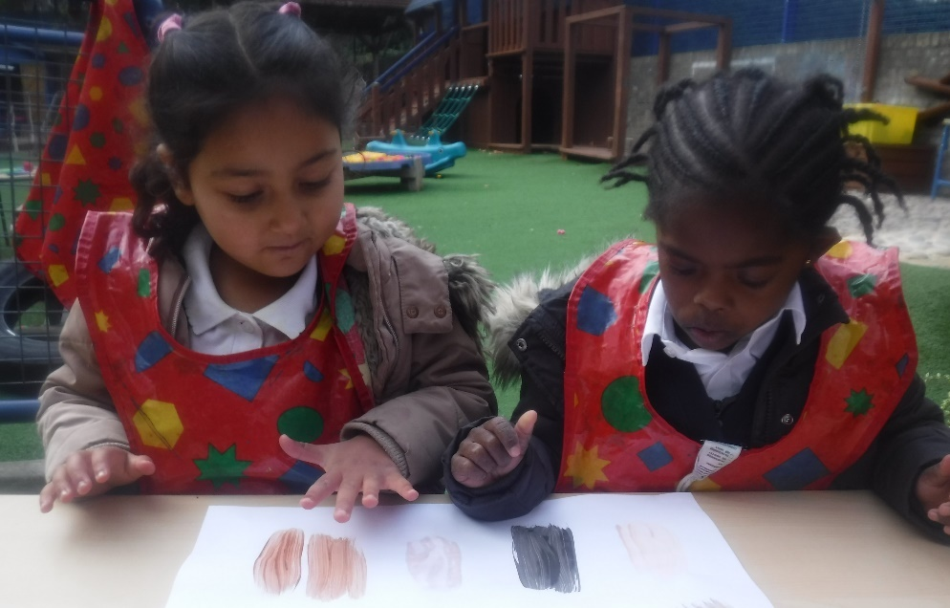
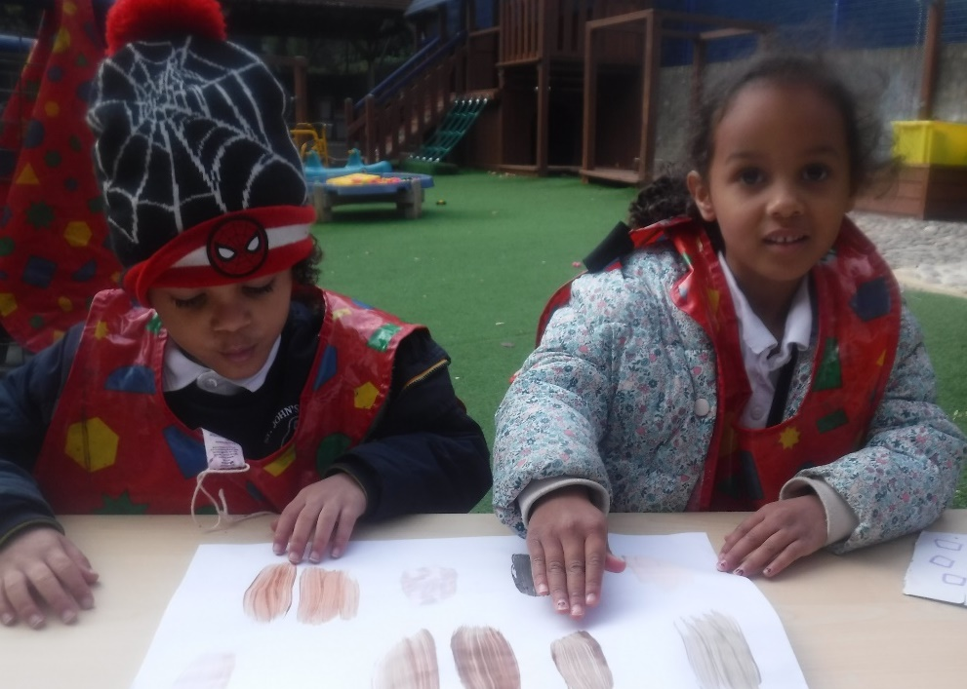
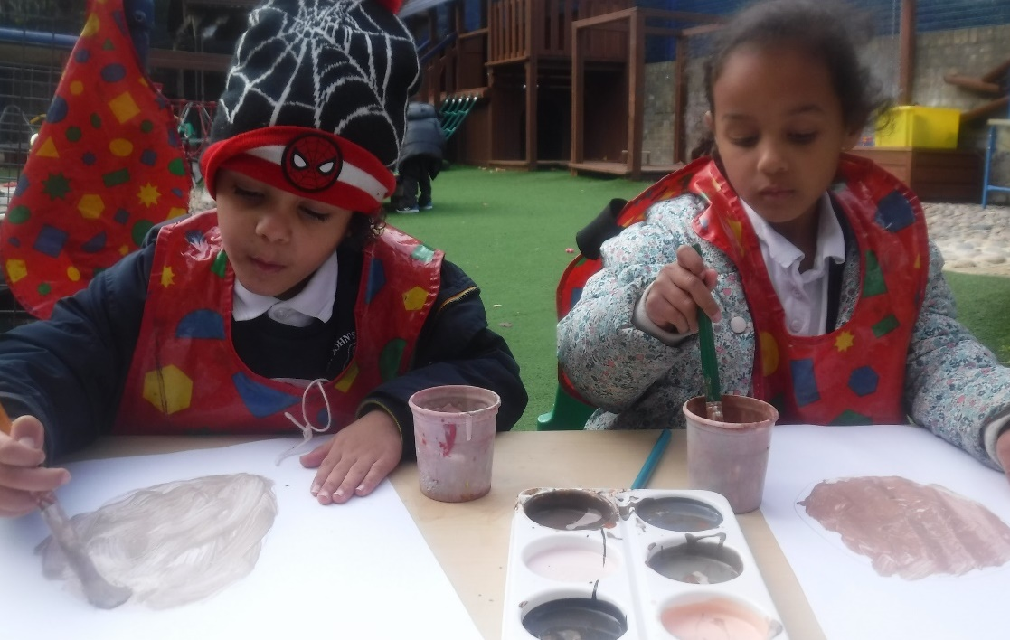
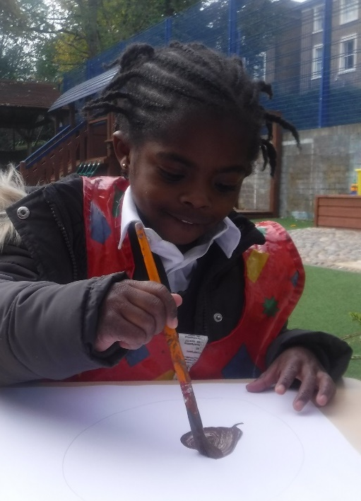
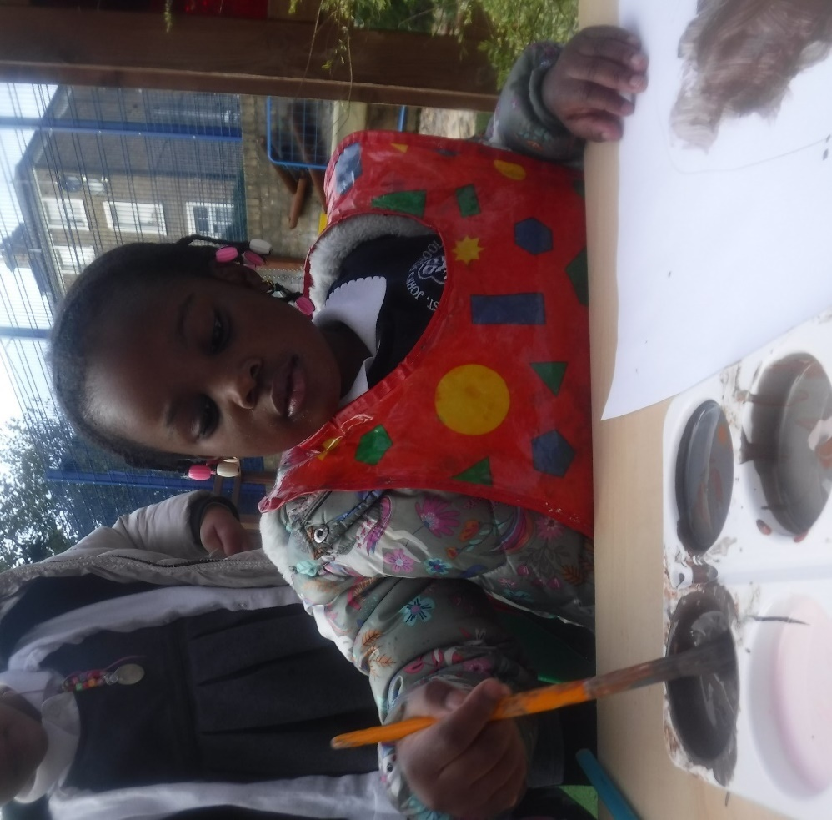
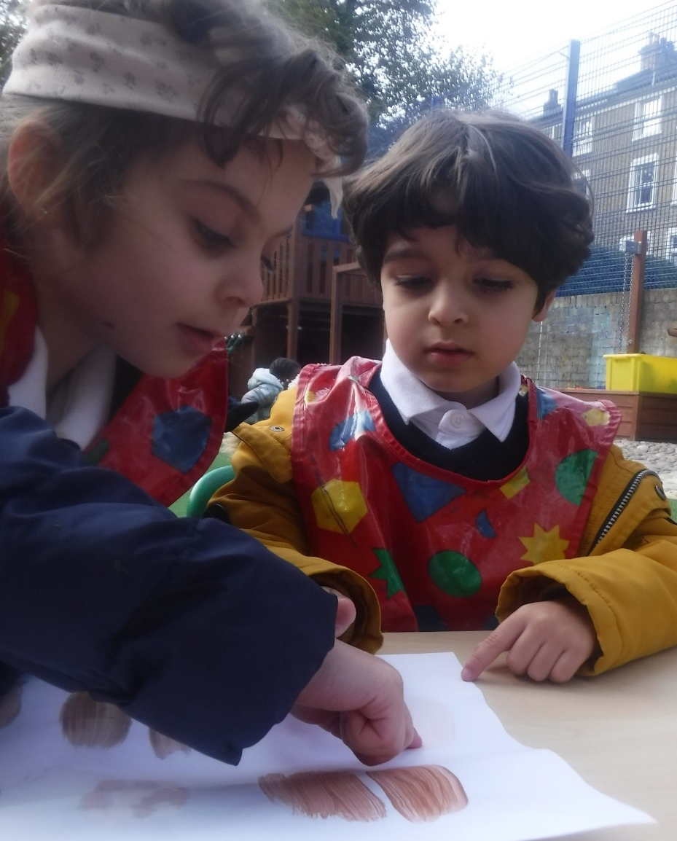
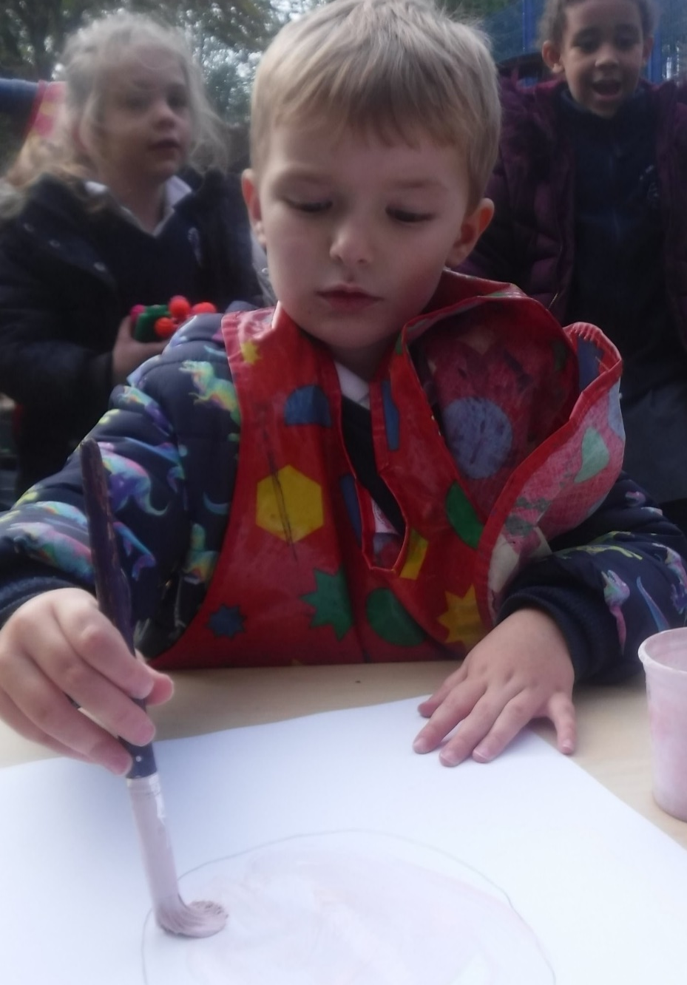
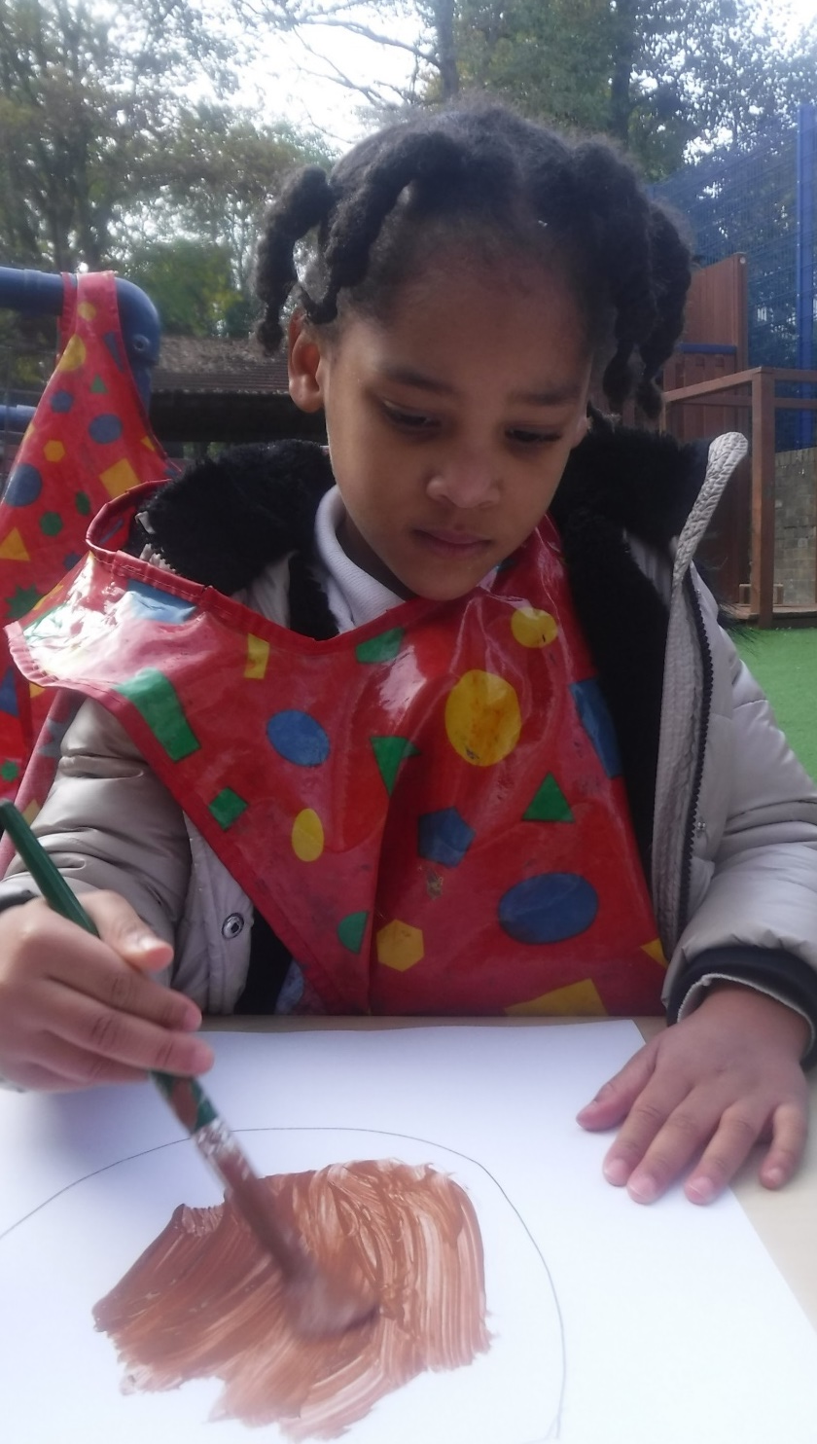
We have started to paint our self portraits. We looked at our skin, matched it to the paint and pained just our faces. Next week we will start to paint our features.

Slide 5
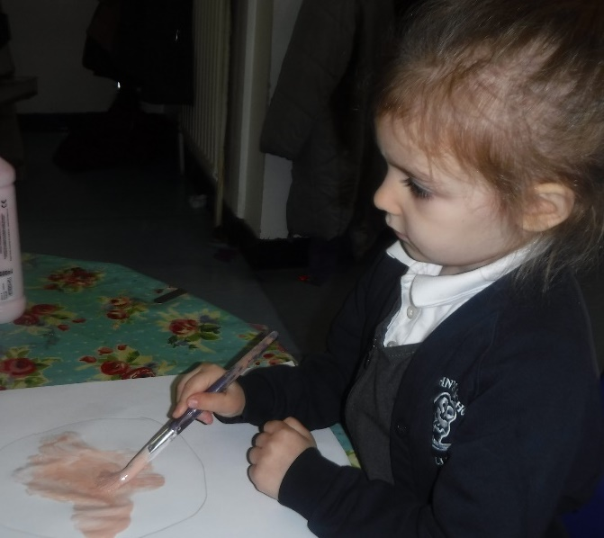
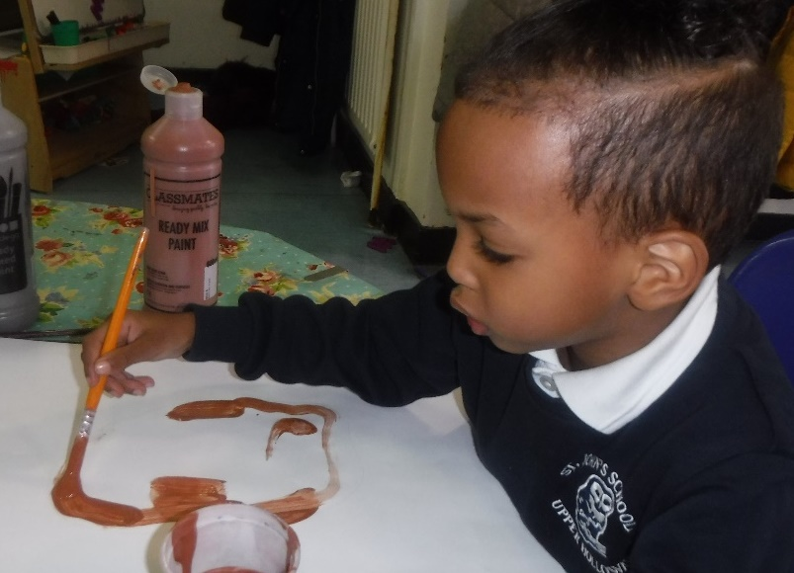
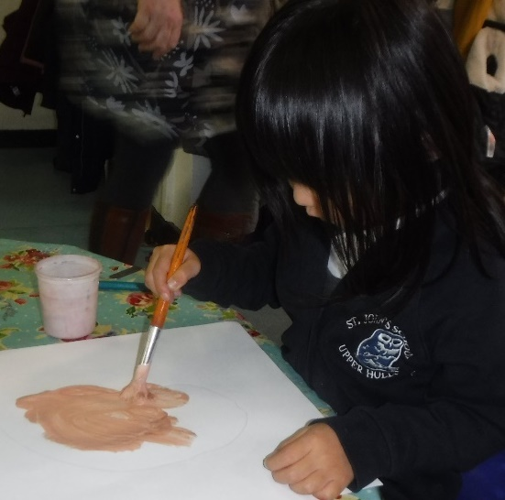
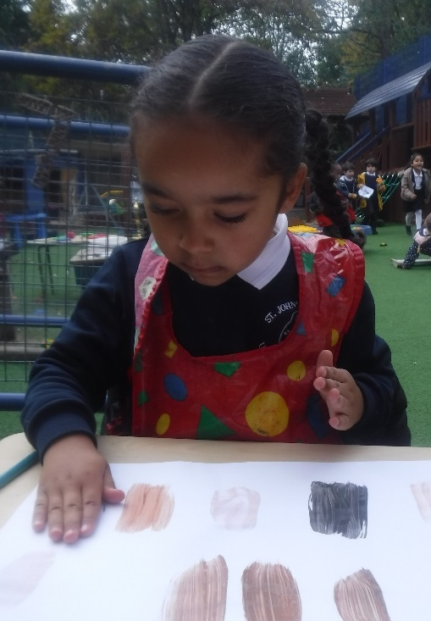
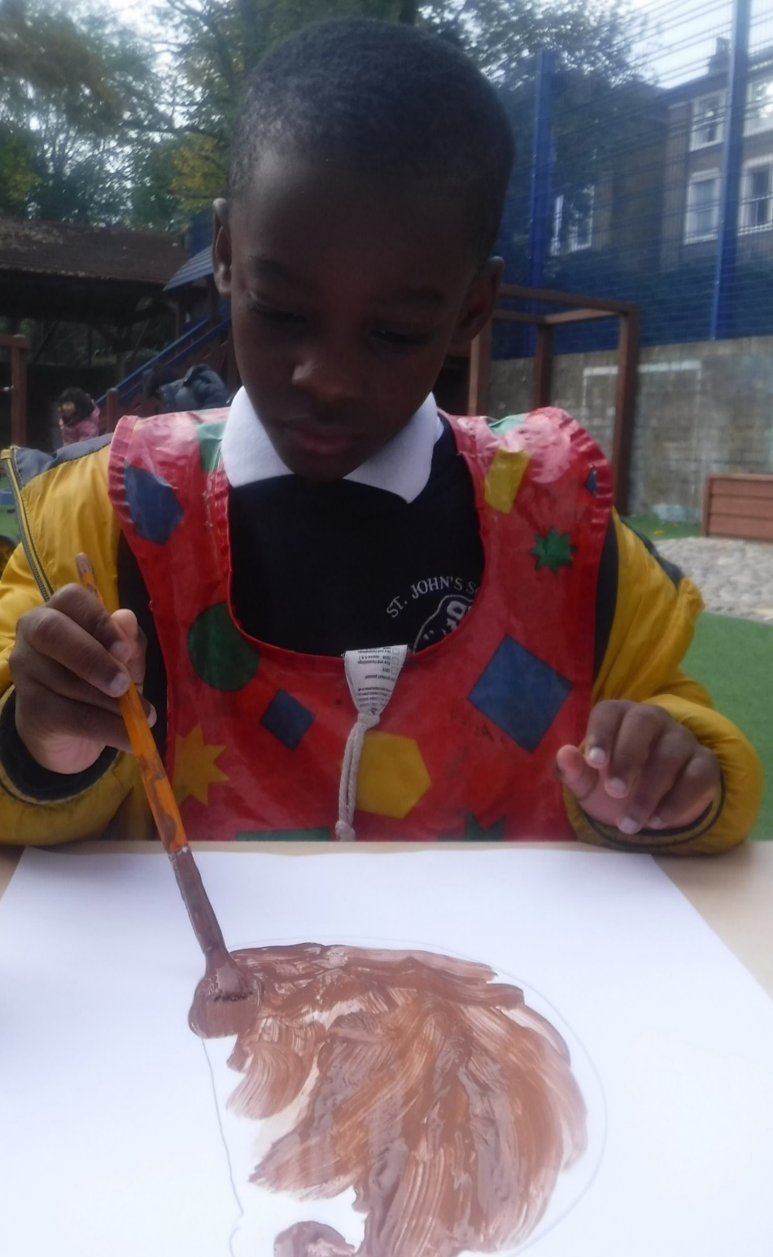
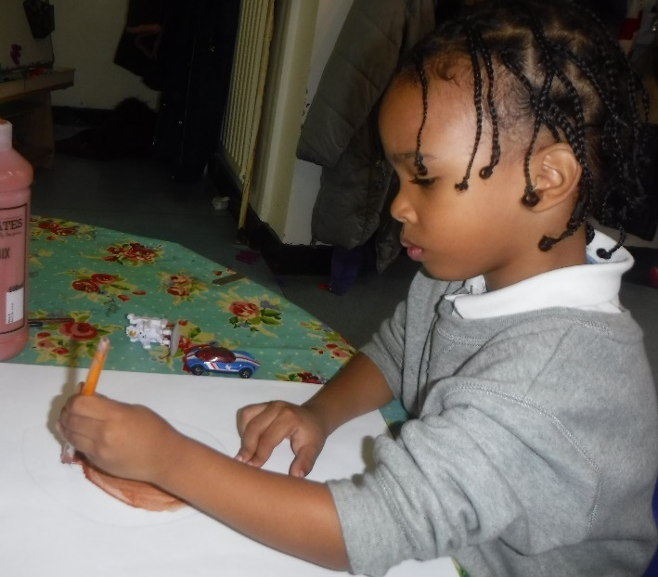
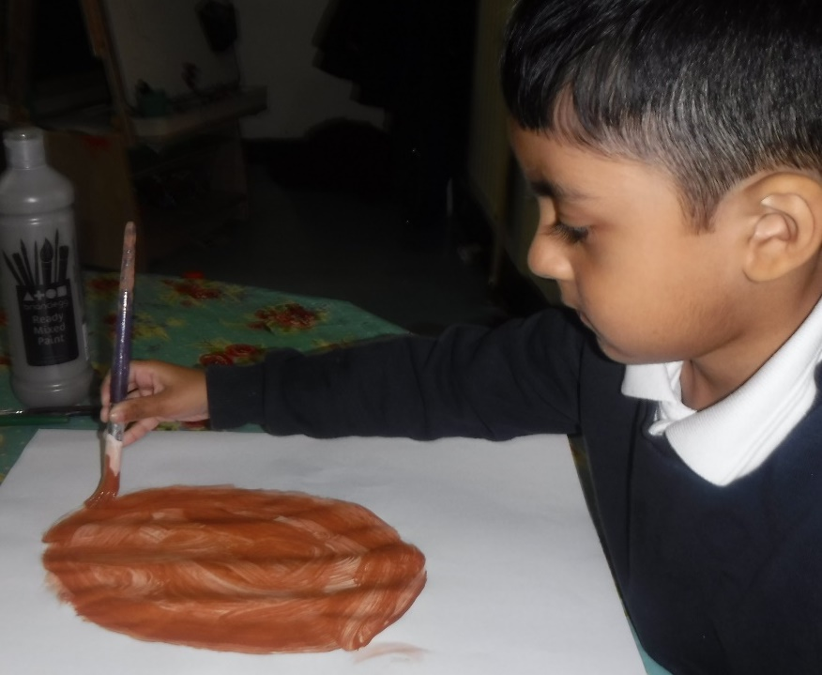
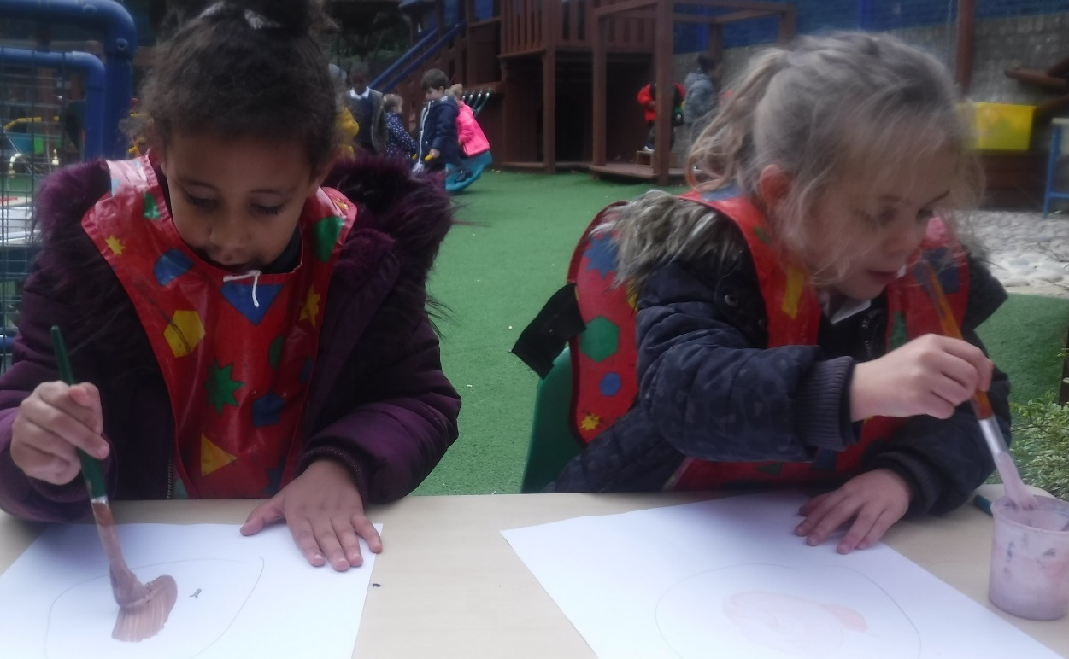
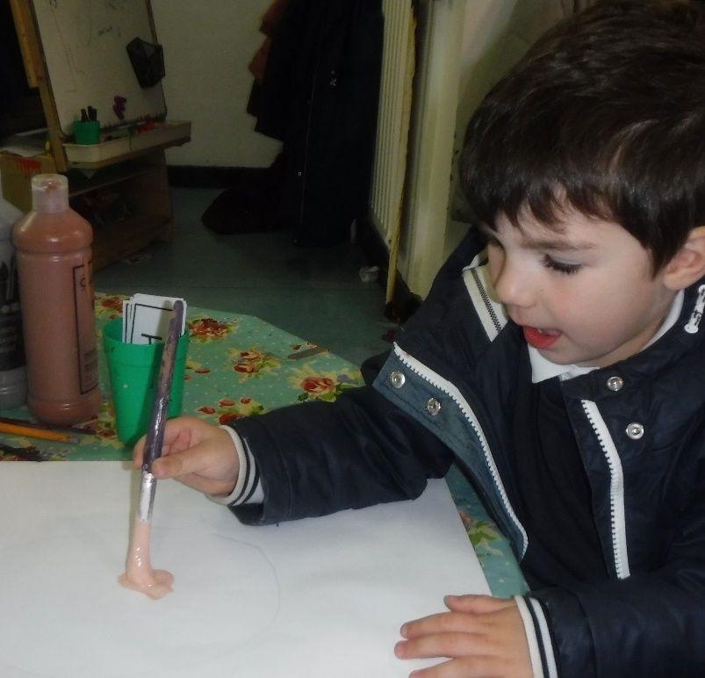
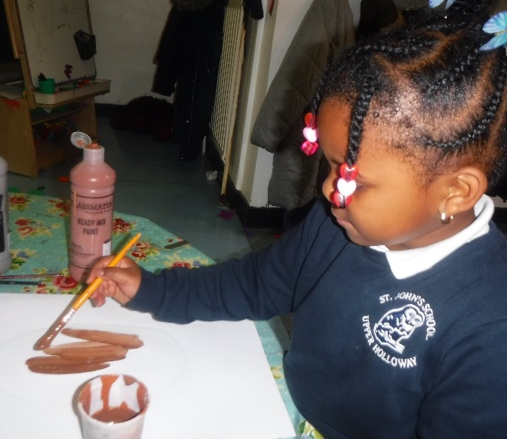
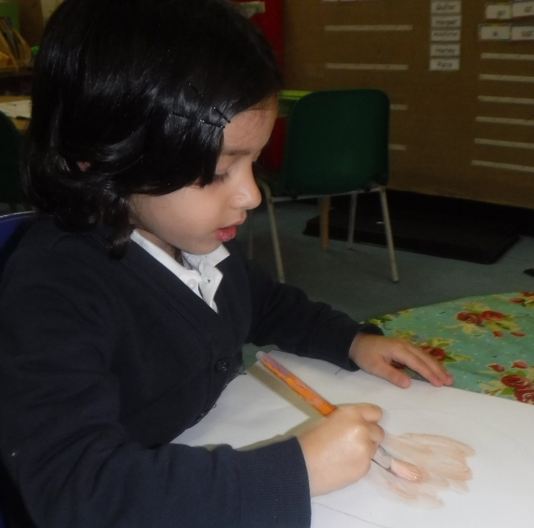
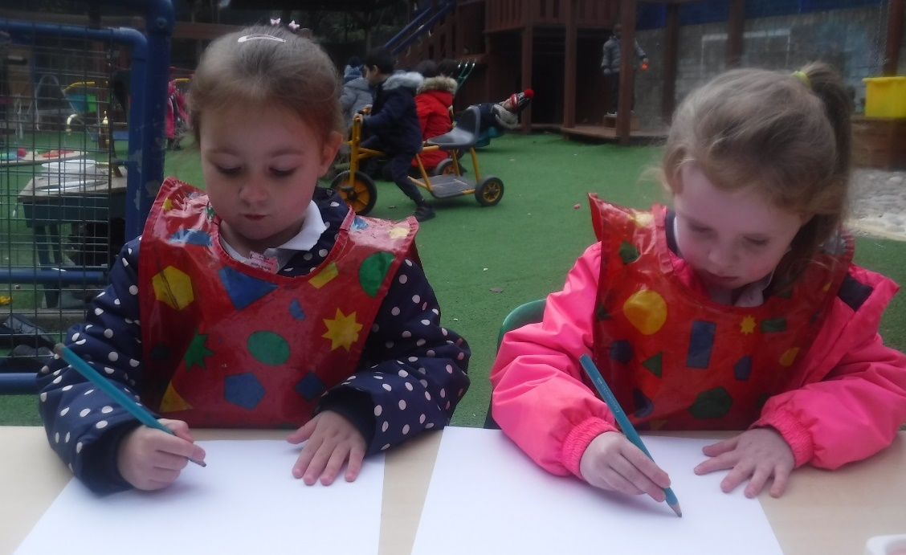
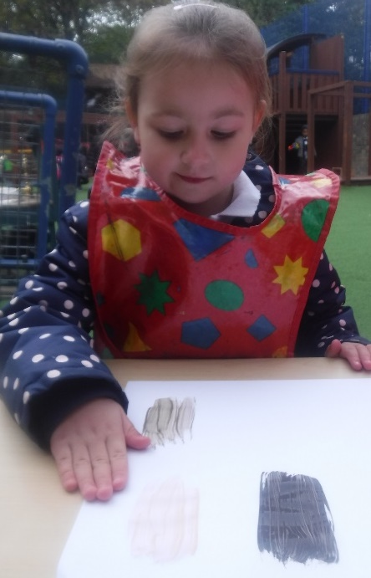

Slide 6
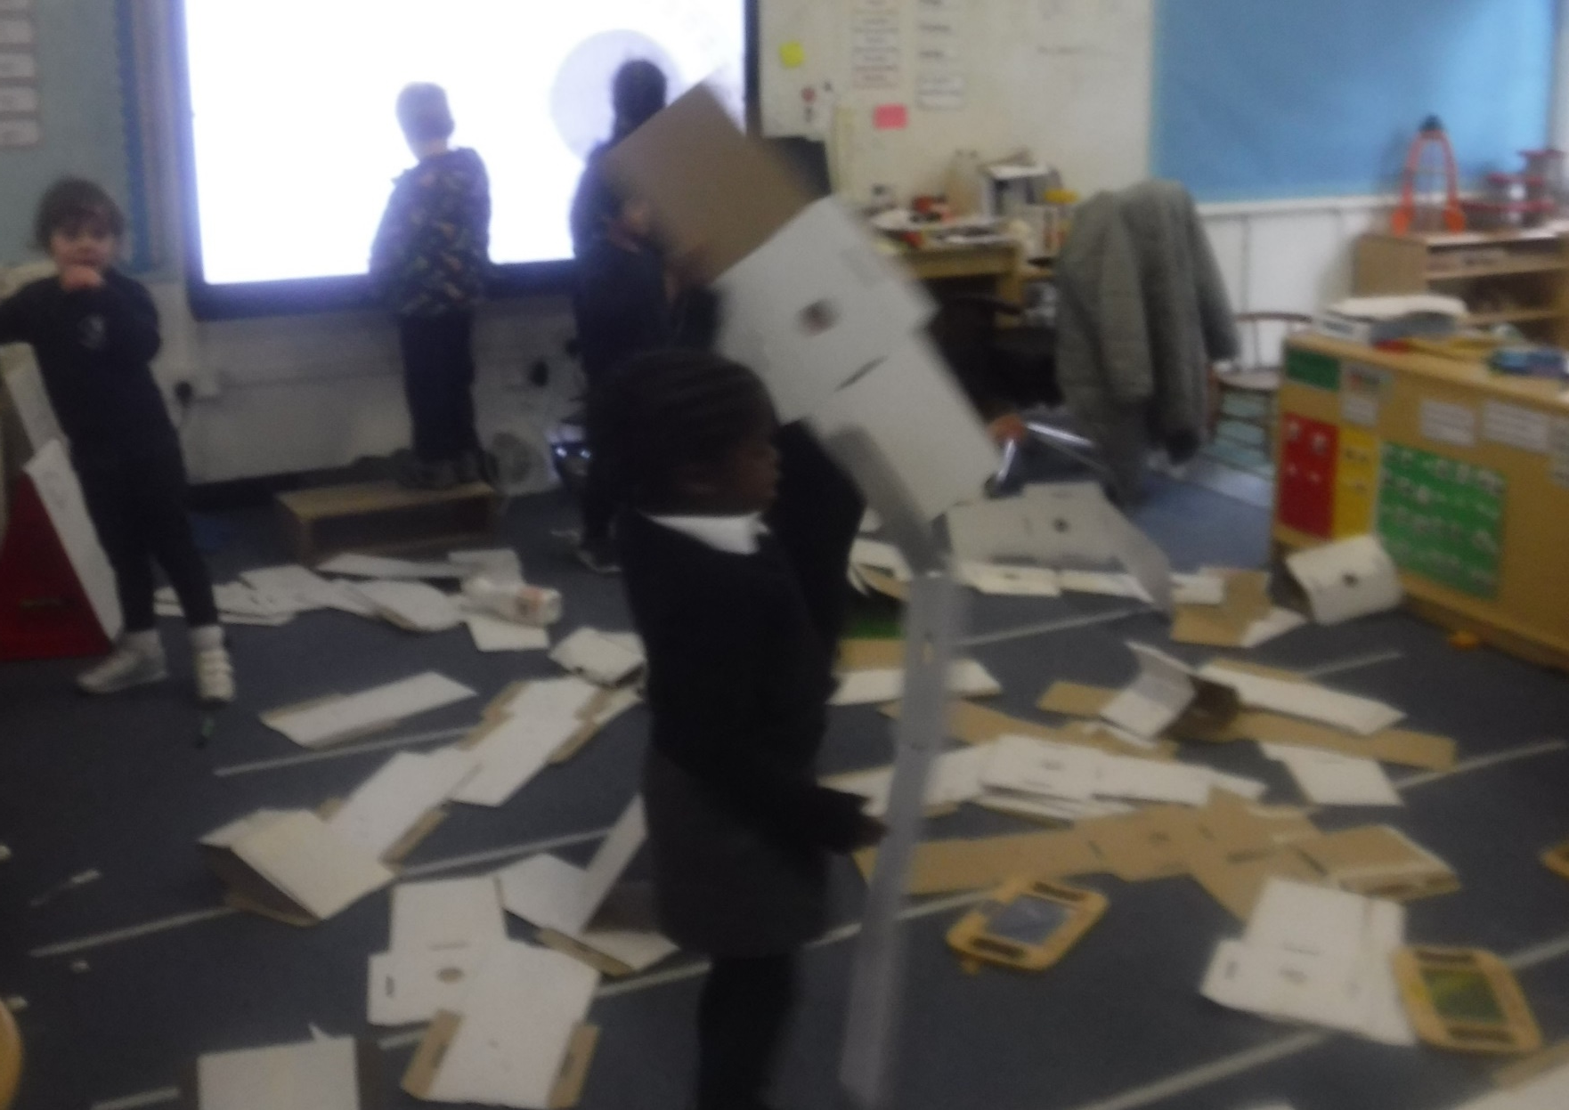
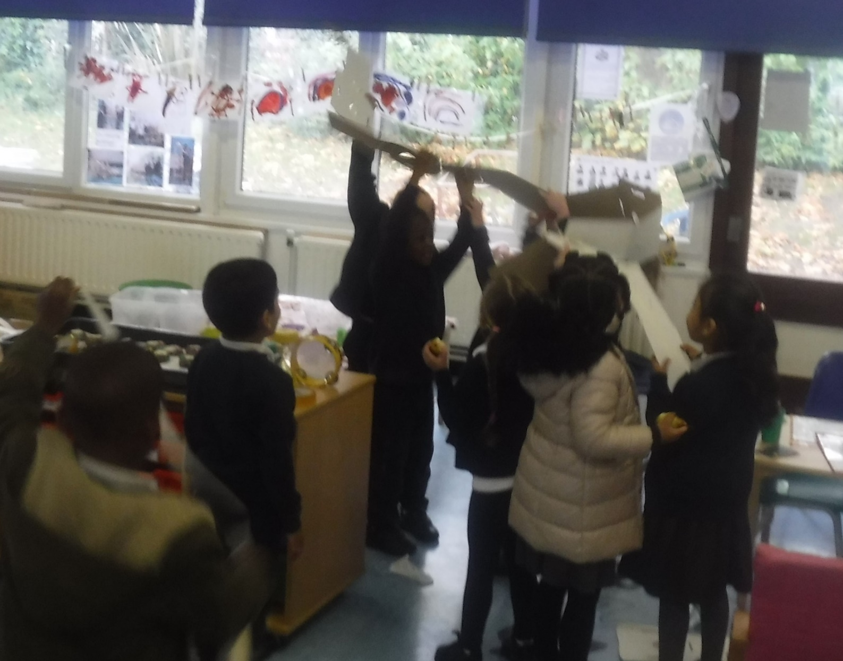
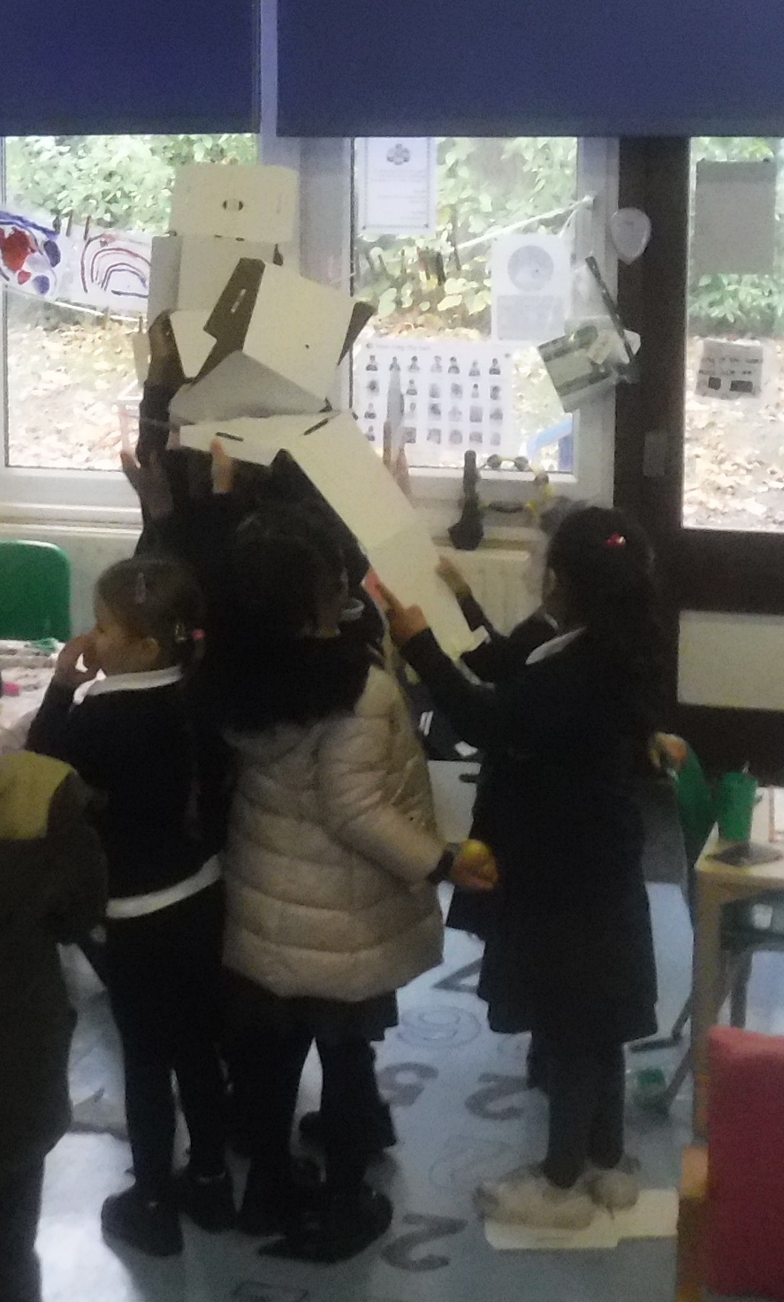
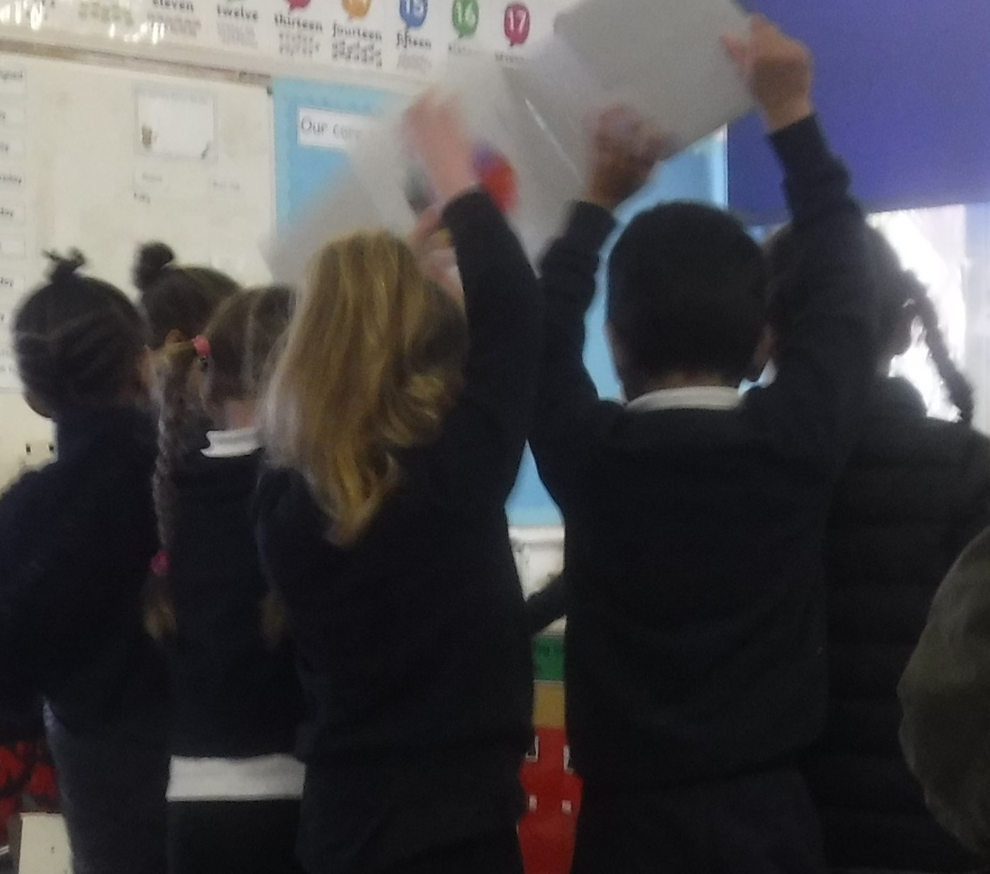
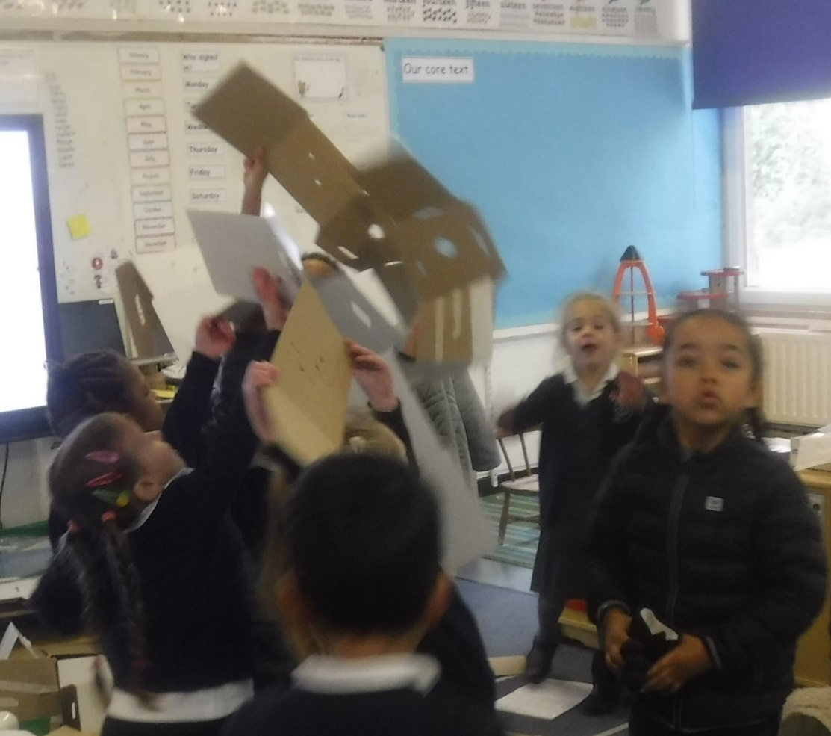
At the beginning of the term the shape robber put all of our wellies on the high beams in the classroom. .
The children worked together to make a ladder and try to get them down. Can you remember why it didn’t work? Is there anything else you could have done to help it?

Slide 7
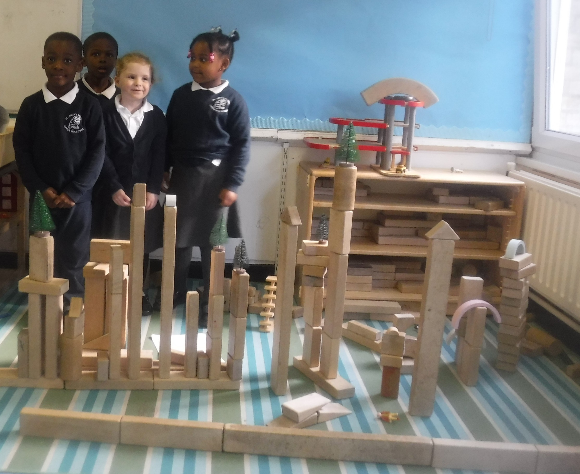
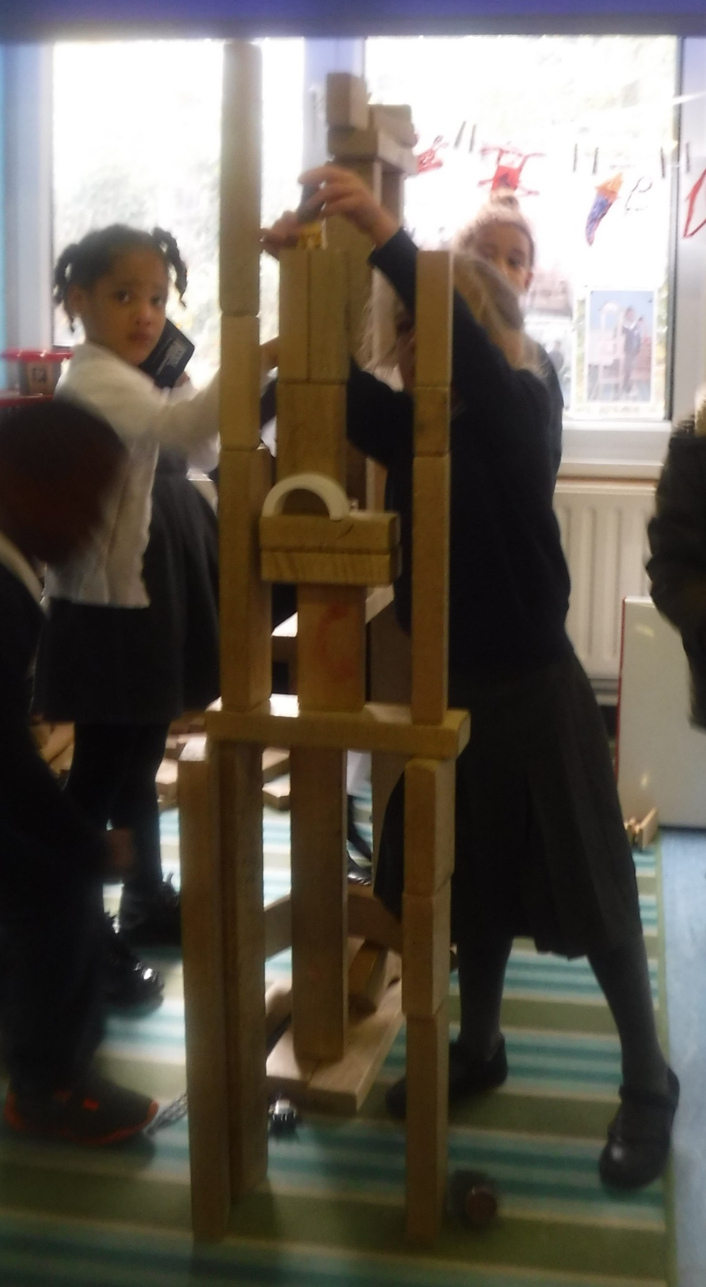
Our amazing buildings! I think that we are better than Year 1!

Slide 8
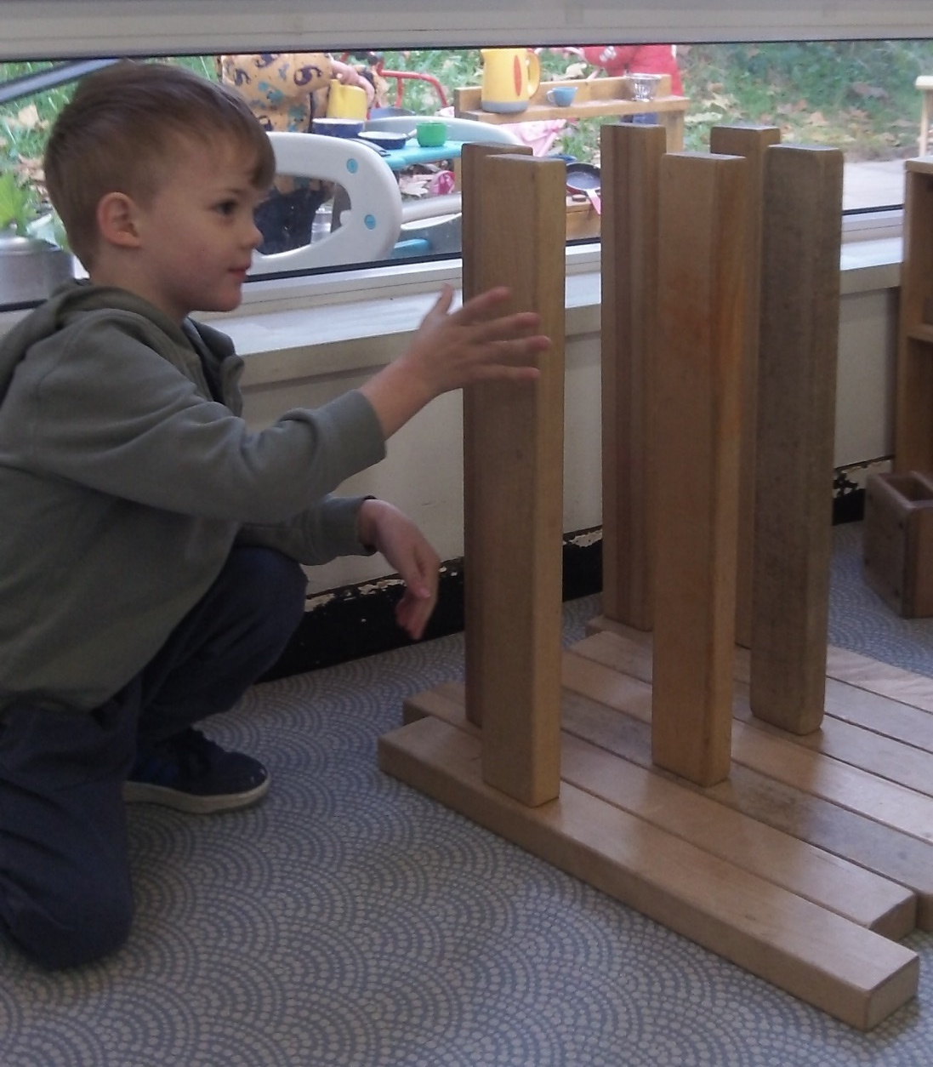
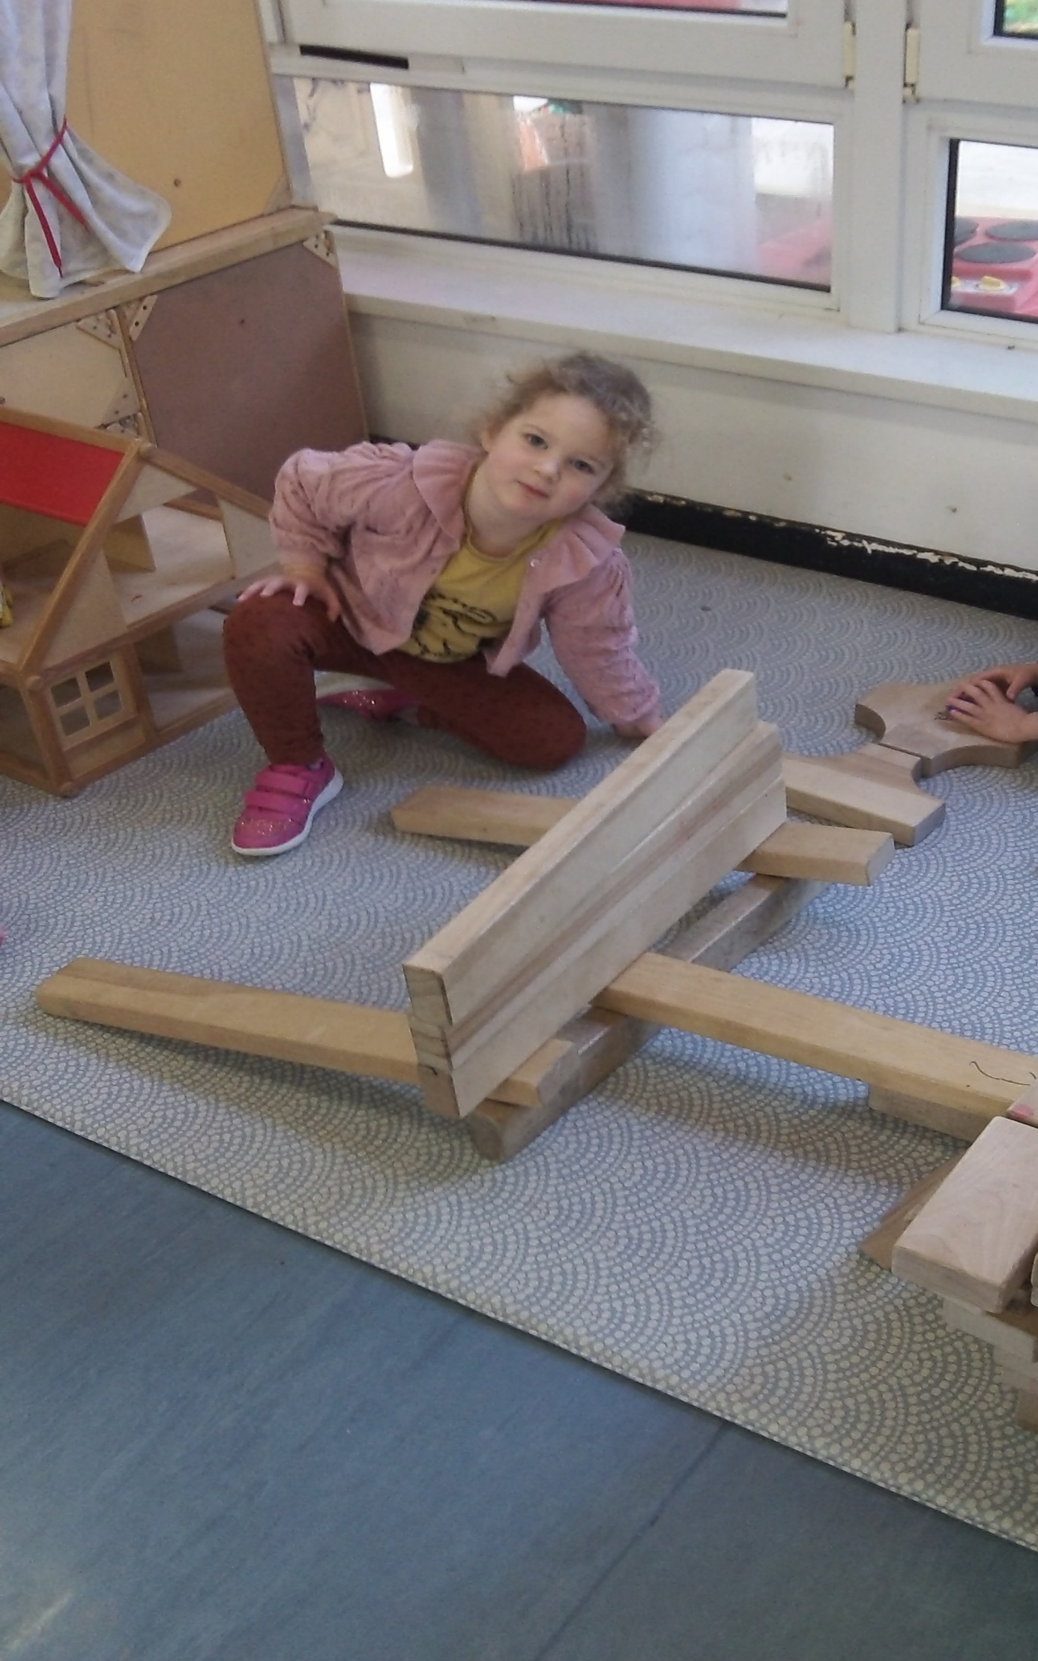
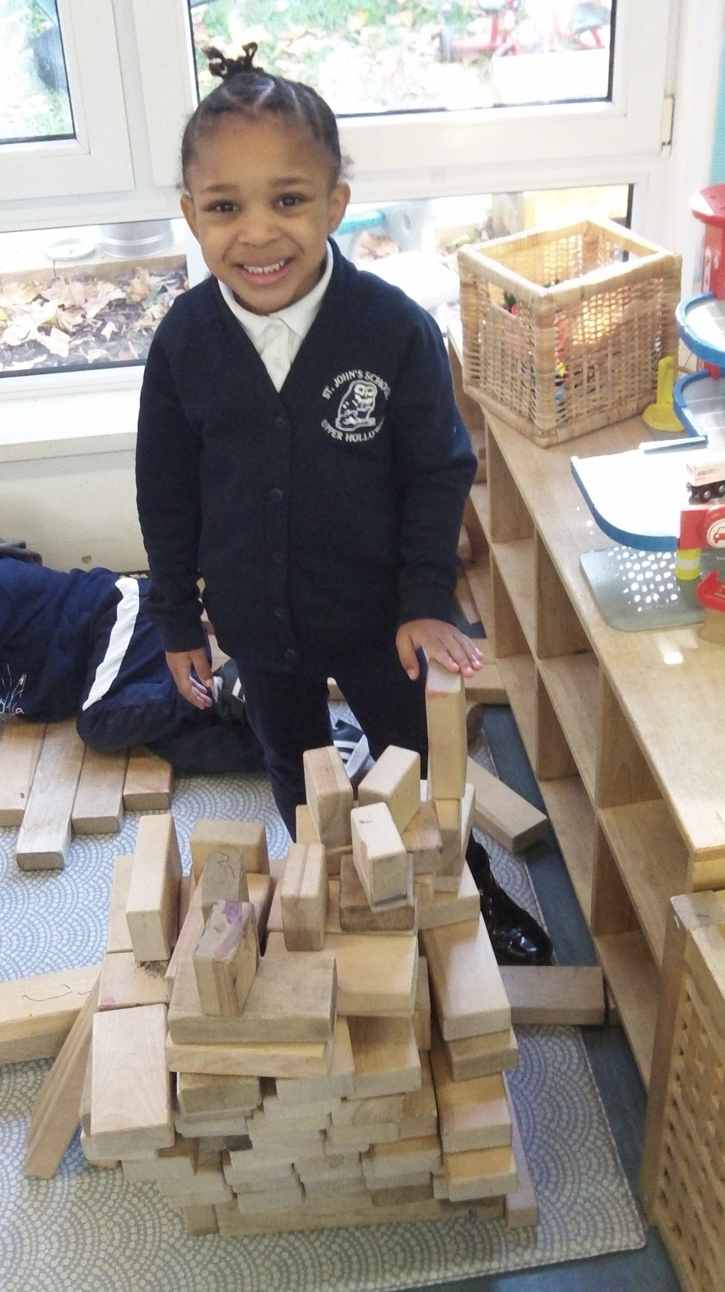
I wonder if you can plan your buildings before you make them?

Slide 9
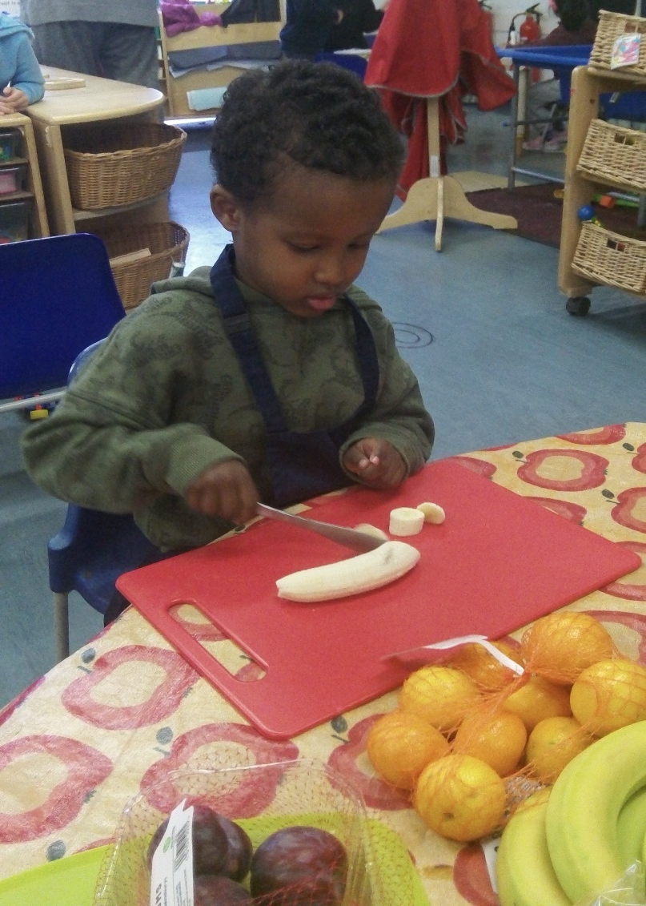
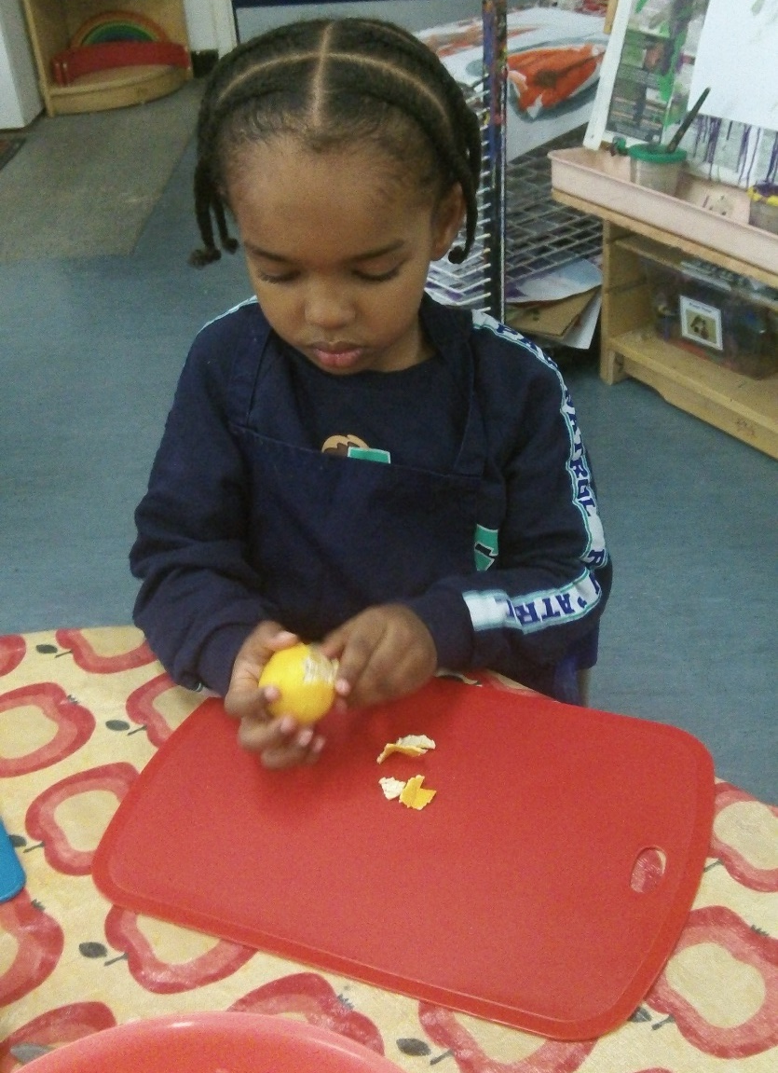
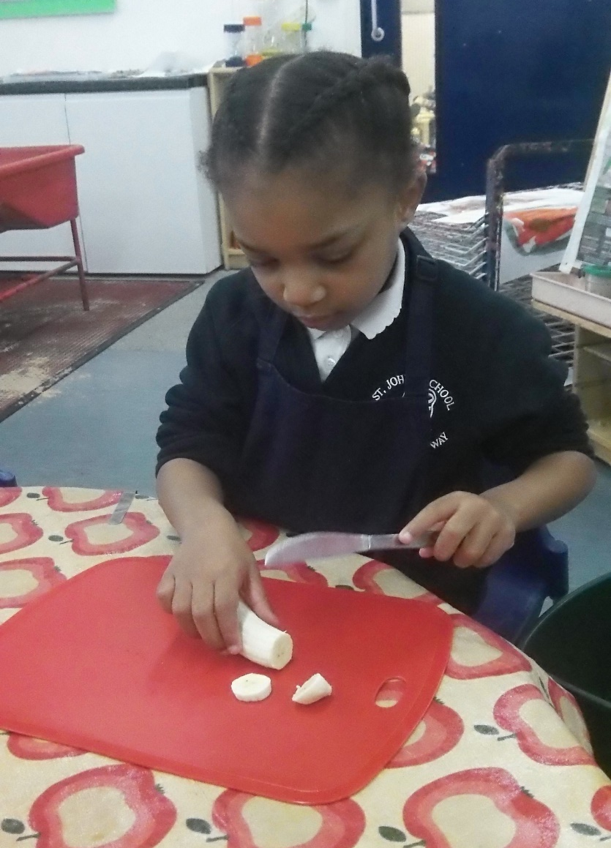
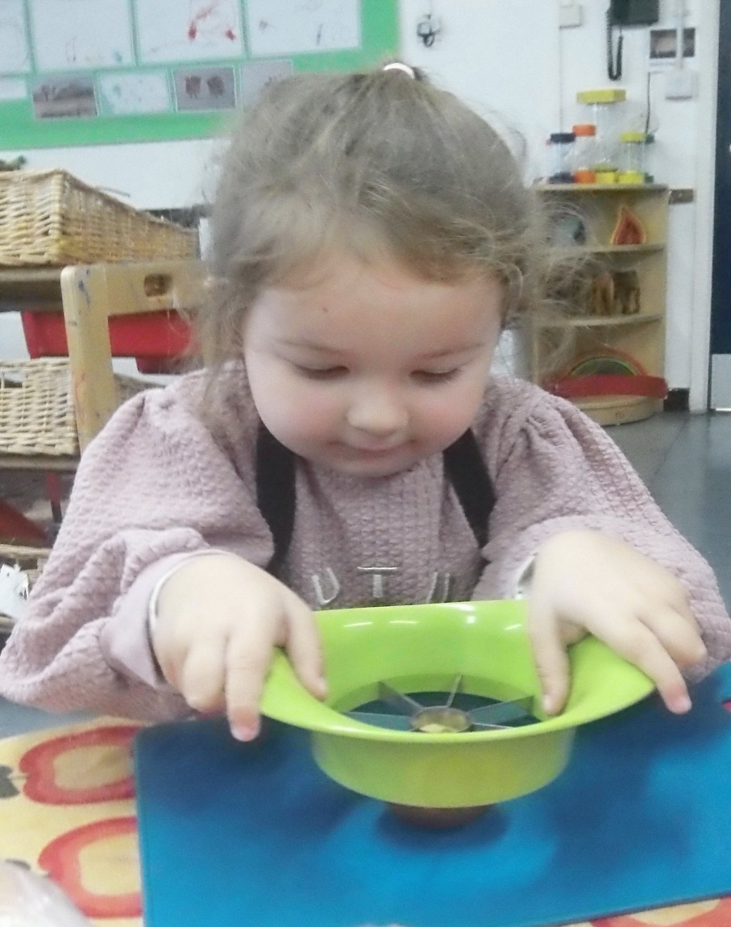
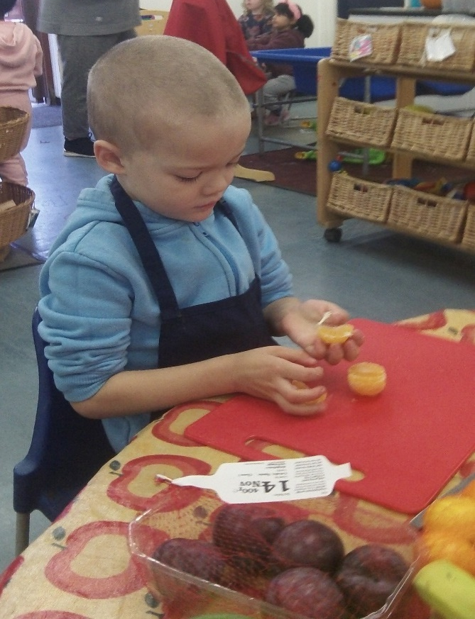
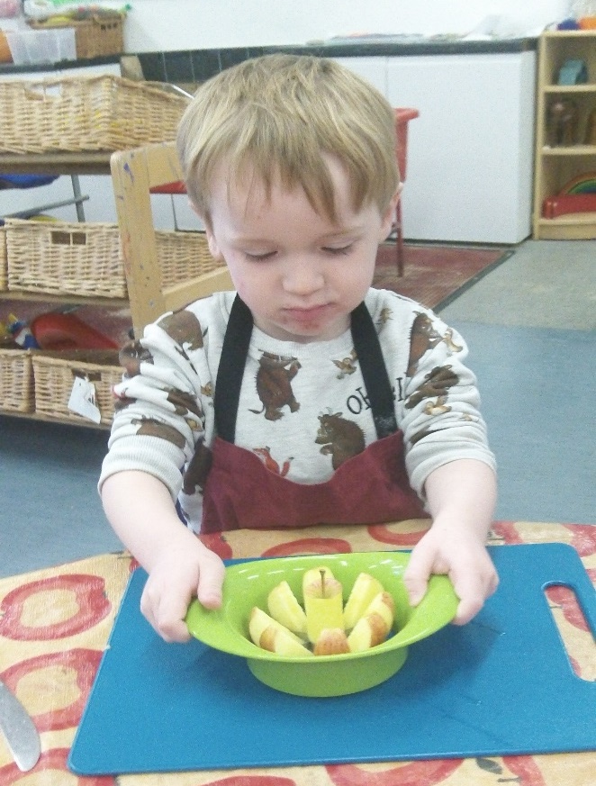
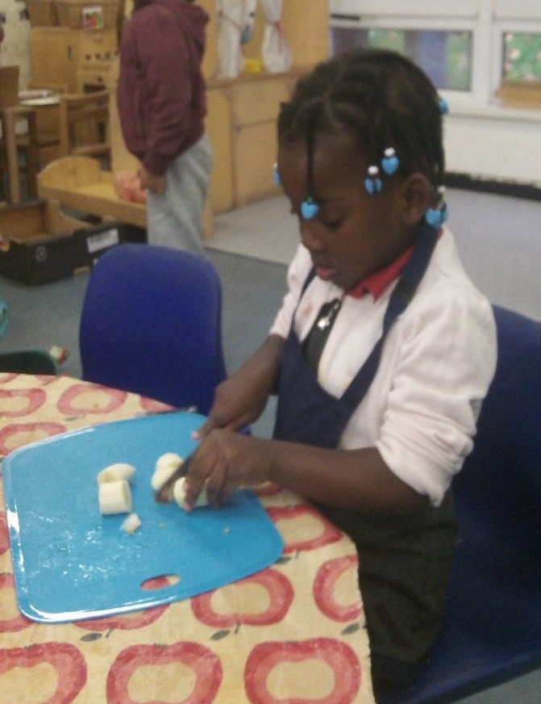
Can you remember how you made your fruit salad? What ingredients did you use?

Slide 10
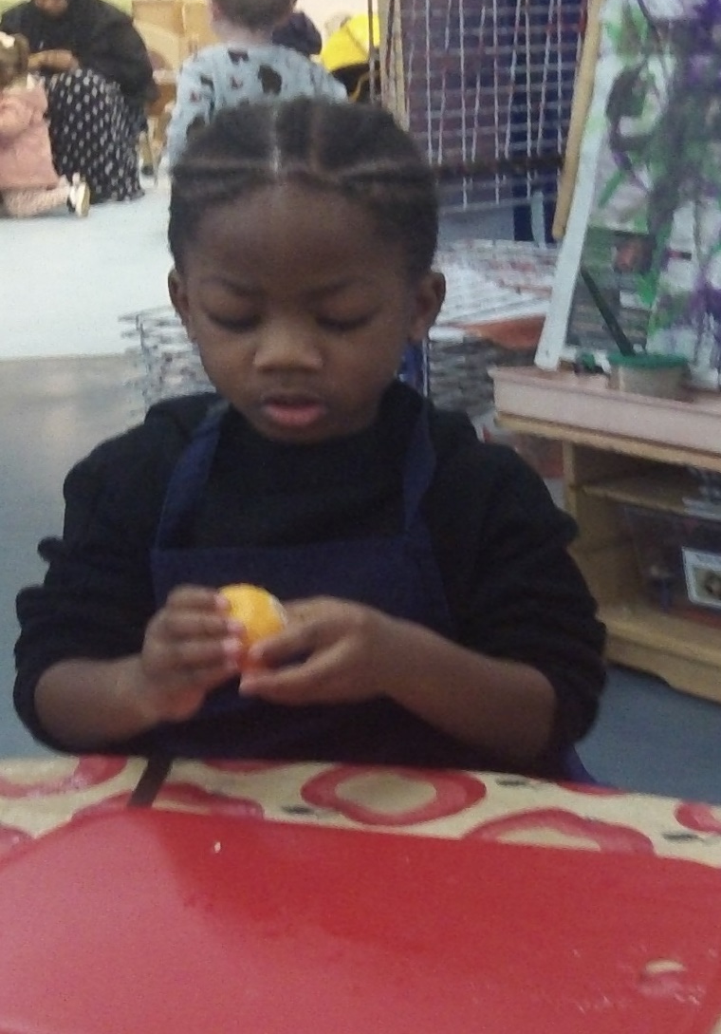
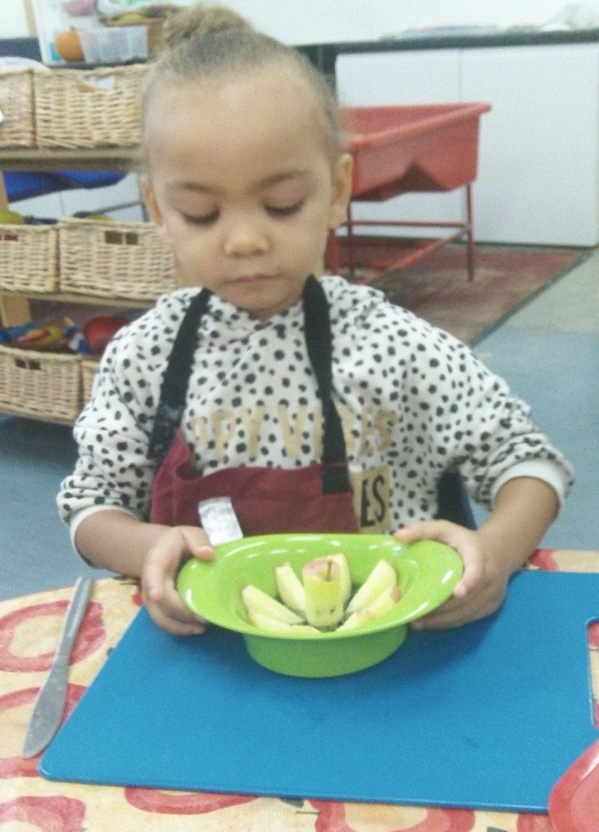
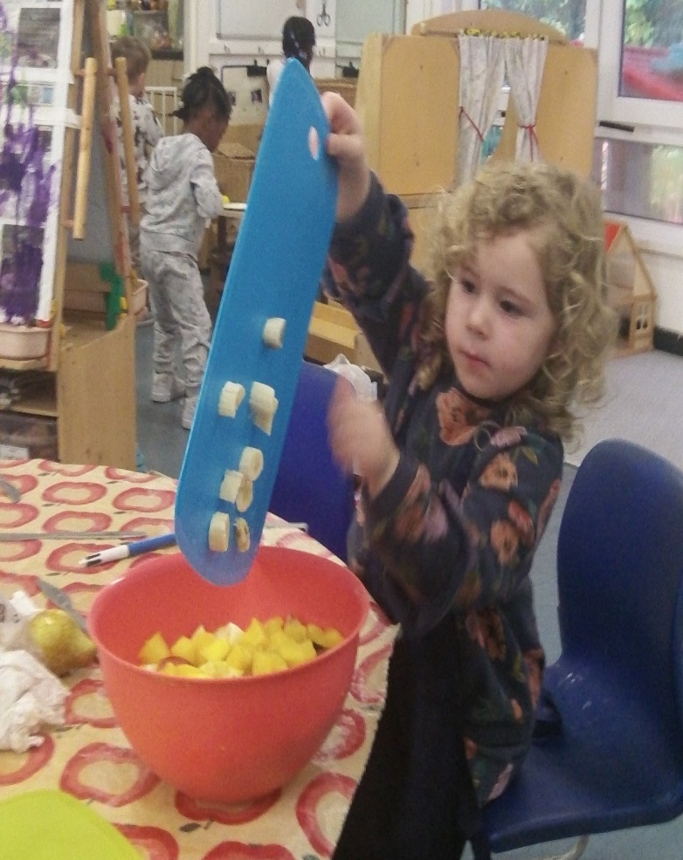
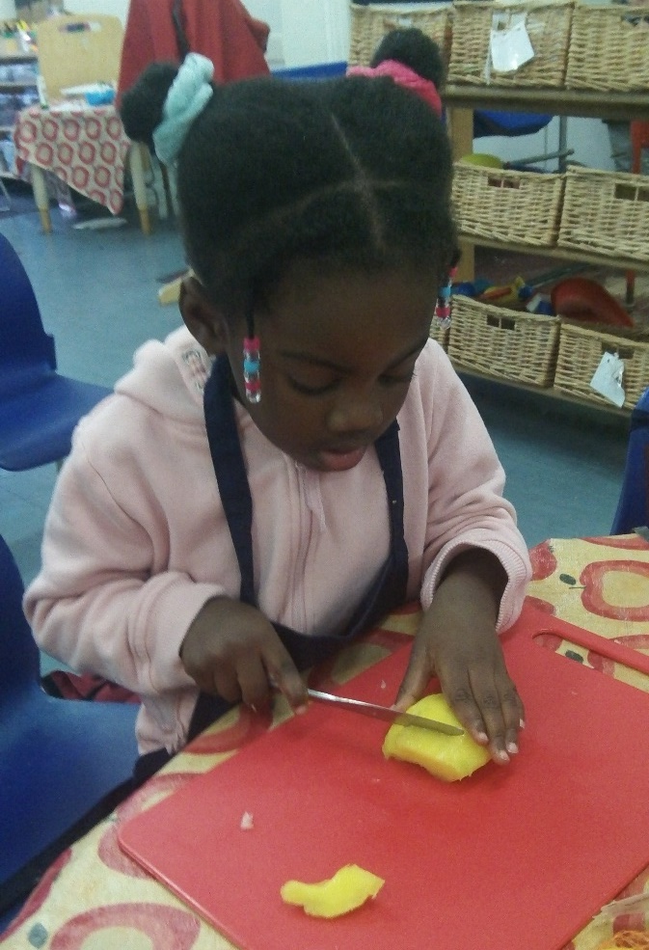
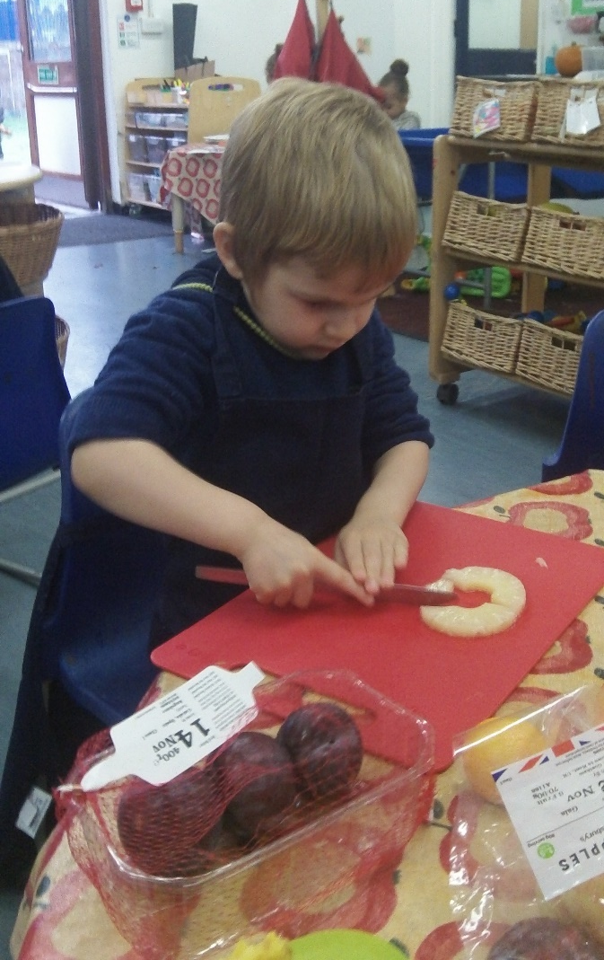
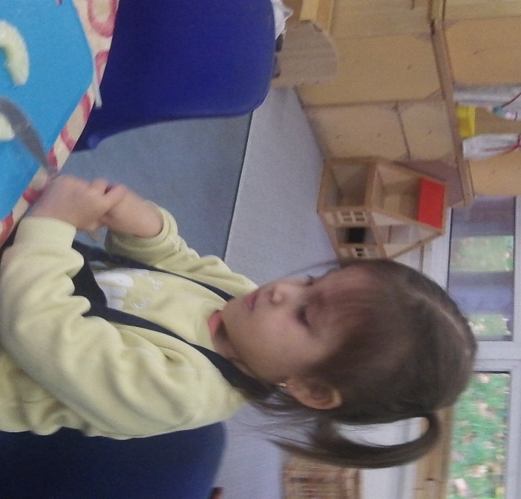
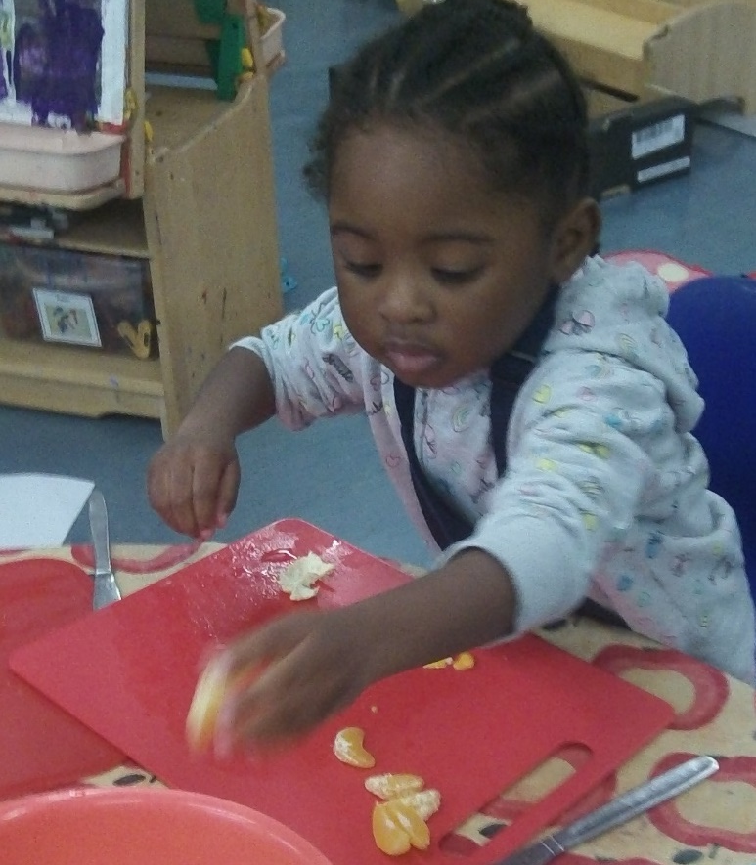
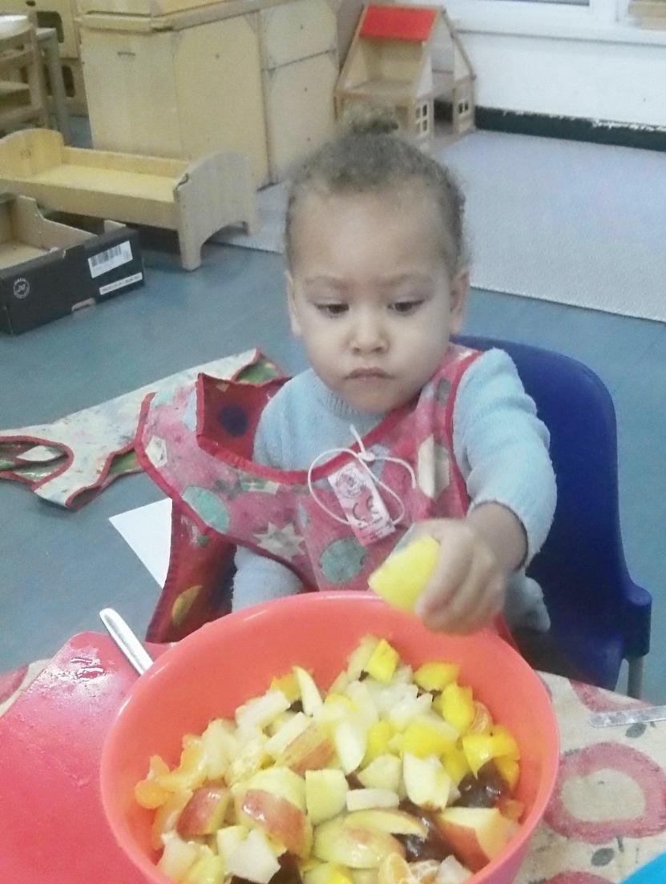
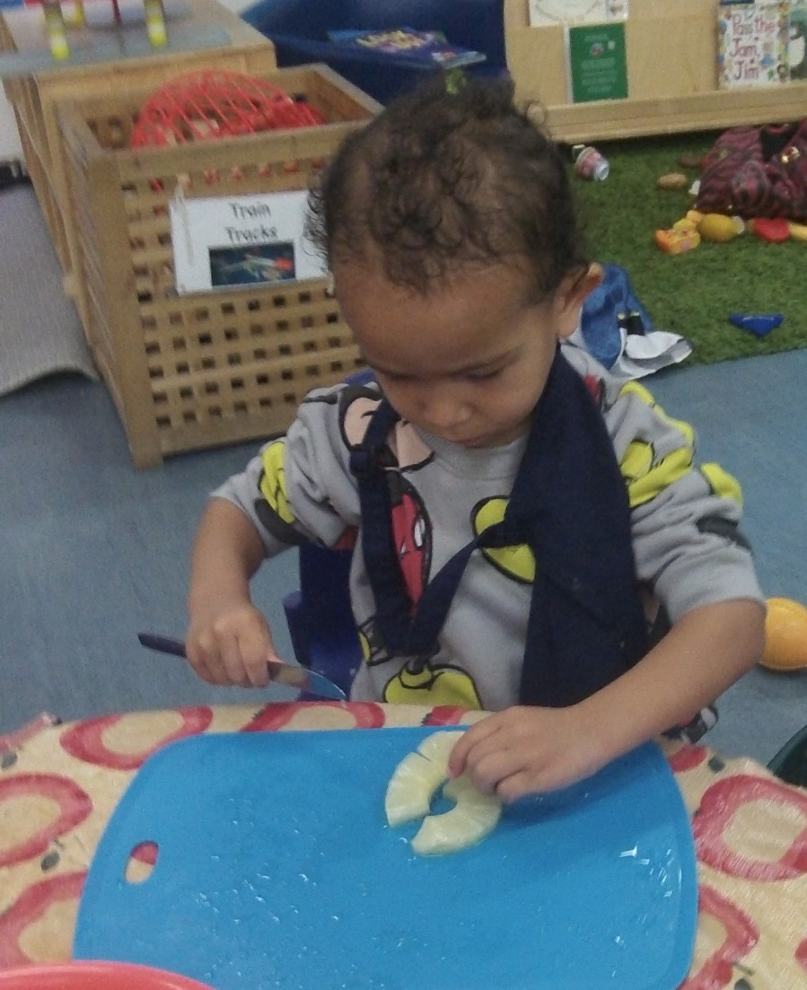
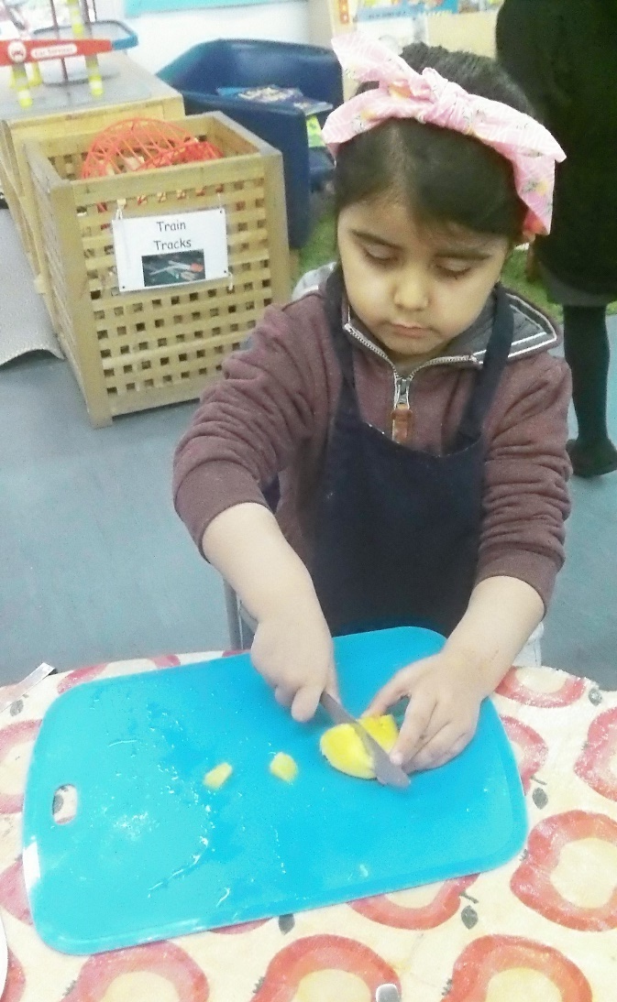

Slide 11
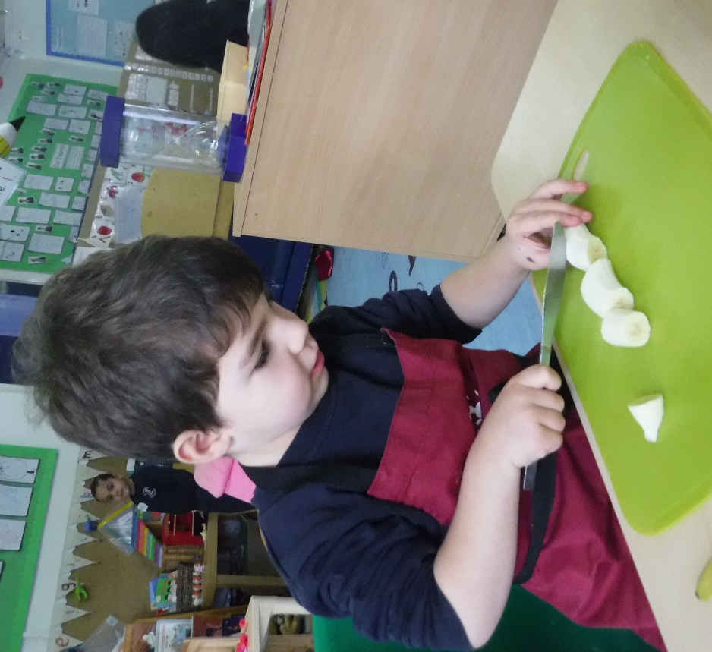










Slide 12



Slide 13









Slide 14












We found lots of bats hidden around the garden. We practised our subitising.

Slide 15













What type of stories did you tell at the Talking Table?

Slide 16









How many skittles did you knock down?

Slide 17









What else did you learn about this week?

Slide 18










Slide 19







