Slide 1
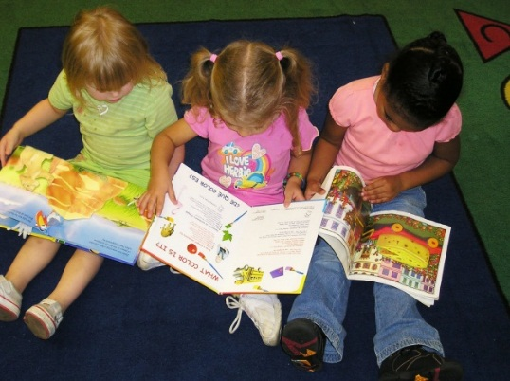

What is early reading?
Children are encouraged to recognise their own name: Self-registration – Find their name card
Listening to lots of stories and joining in
with familiar words/sounds
Talking about story pictures
Story tapes, props, making books
Print in the environment

Slide 2


Early Sound Work
Learning letter names is great but the crucial thing is to learn letter sounds.
Distinguishing between sounds:
Listening walks
Sound effect games
Musical instruments
Looking at car number plates
Shop names-all children recognise McDonalds!

Slide 3
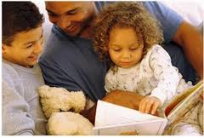
All parents can help by…
Reading to their children
Looking at print in the environment
Talking about the pictures in books
Making reading fun!

Slide 4

Phonics a b c d e
What is phonics?
The relationship between letters and sounds.
Helps pronunciation of words and will be able to decode words. Patterns.
Words are made up with small segments of sound. i.e C-A-T G-R-EA-T
READING!!

Slide 5
Ways that you can help at home!
Ask your child to say words beginning with s sound. What sound does it begin and end with?
Practise the phoneme sounds with Mr Thorn!
http://www.mrthorne.com/
You can also listen to jolly phonics
http://www.youtube.com/watch?v=1he7WQ0N-_M
REMEMBER TO KEEP POSITIVE AND KEEP
READING!

Slide 6
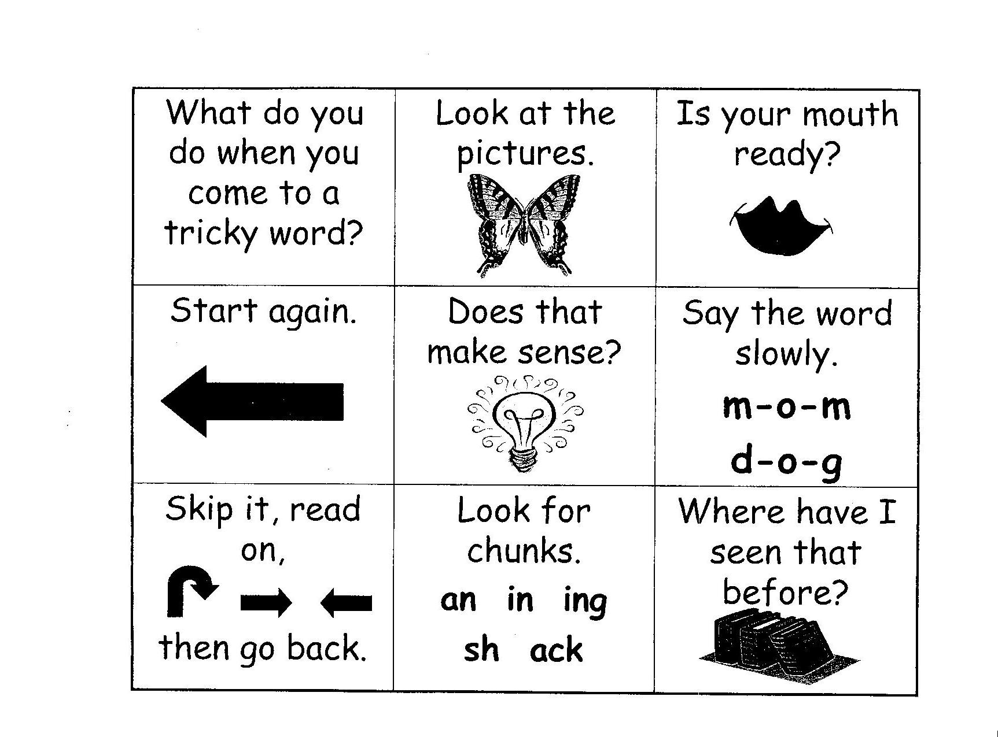
Reading strategies

Slide 7
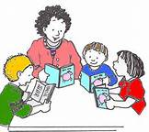
What is guided reading?
15-30 mins every day
Different activities on rotation
Read to an adult twice a week
Children read at their own speed
Progress is closely monitored and recorded daily.

Slide 8

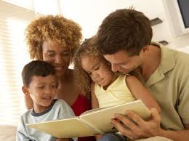
High Frequency Words: What are they?
Why are they important?
Reading at home
Reading Records
Reading to children
http://www.youtube.com/watch?v=UG-FOstzjAY&safe=active

Slide 9
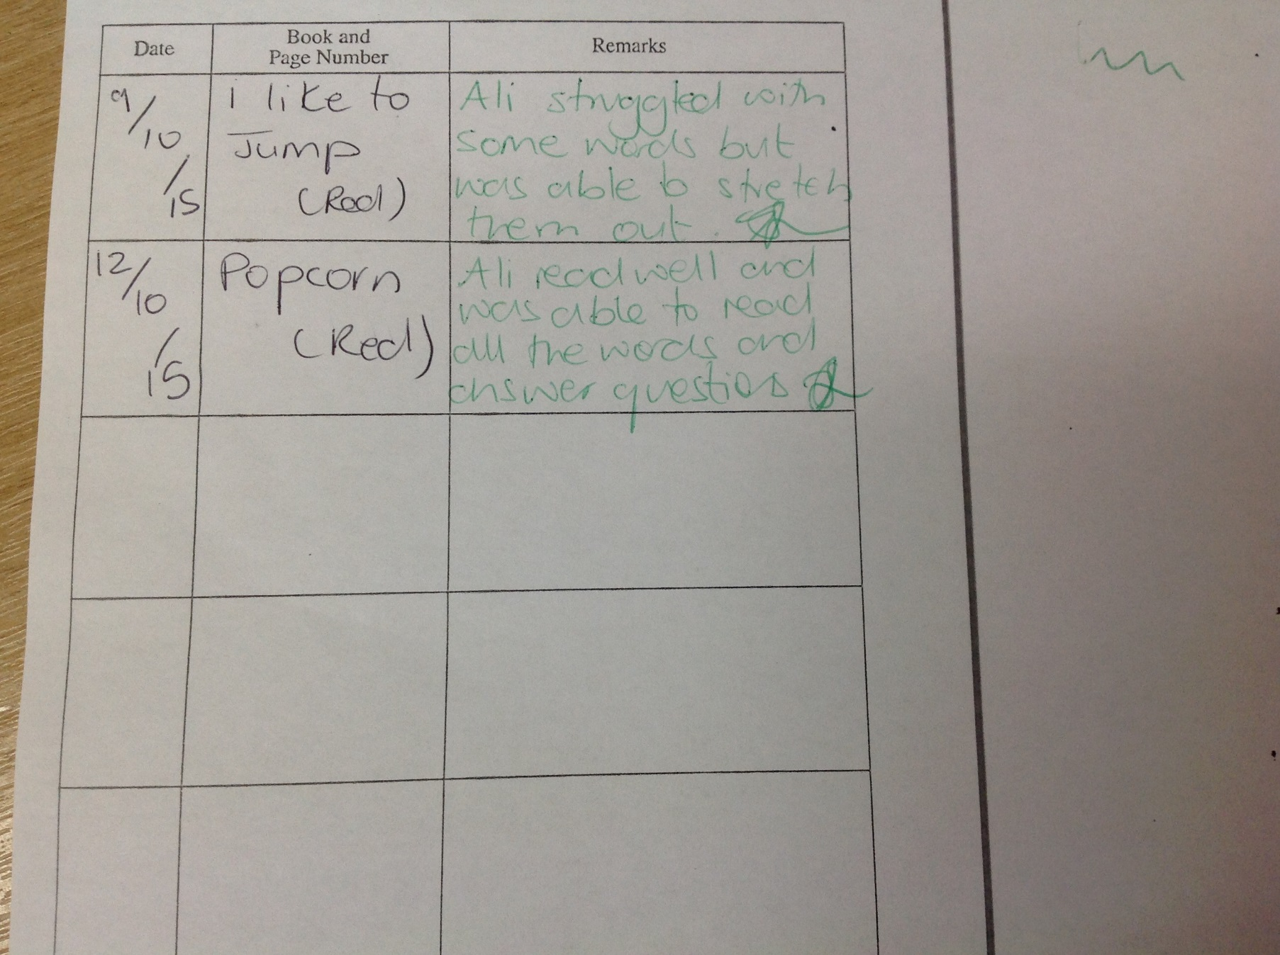
Reading Record

